Slide 1
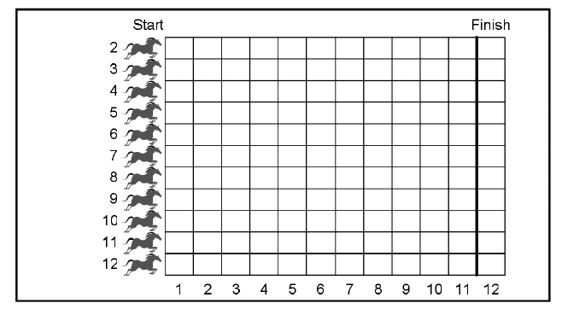
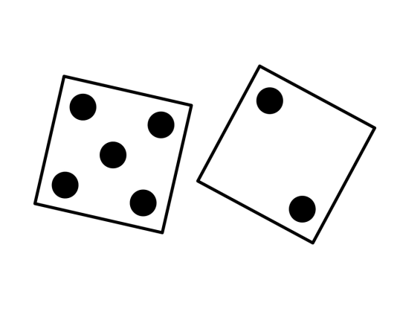
Activity: Dice Races
You will need; A Pencil, two dice, counters and a racing grid.
Before you begin, predict a winner and where you think all the horses will be once the first horse crosses the finish line.
Work in pairs. Take turns to throw the dice, then add up the score on the dice and move the corresponding horse. Continue until one horse crosses the finish line. Draw a mark at the end of the grid to show they have won a race.
Repeat this 3 or 4 times, is there a pattern that you have noticed and can you think why this might be the case?

Slide 2
Activity: Dice Races Extension
Try a few more experiments and see if you can predict what will happen.
1. The difference between the dice (highest take away lowest) Use horses 1 - 5
2. The highest number Use horses 1 - 6
3. If a multiple of that horse is used Use horses 2 – 6 (can you think why 1 isn’t used? What would happen if you included it?)

