Slide 1
National 5 Applications of Maths
Budgeting
Budgeting Calculations
Exam Style Questions

Slide 2
National 5 Applications of Maths
Budgeting
Budgeting Questions
Example 1: Sophie is saving to buy a new laptop. She saves £28 a week for a laptop costing £495. Will she have enough money in 15 weeks?

Slide 3
National 5 Applications of Maths
Budgeting
Budgeting Questions
Example 2: The following table to calculate the cost of loan repayments, based on how much you borrow and how soon you wish to pay it back.
 | 300 months | 240 months | 180 months | 120 months | 60 months
£30 000 | £220⋅76 | £240⋅80 | £277⋅29 | £355⋅35 | £600⋅45
£25 000 | £202⋅86 | £218⋅41 | £247⋅53 | £311⋅20 | £514⋅02
£20 000 | £162⋅29 | £174⋅73 | £198⋅03 | £248⋅96 | £411⋅22
£15 000 | £131⋅23 | £139⋅90 | £156⋅78 | £194⋅23 | £315⋅15
£10 000 | £93⋅91 | £99⋅35 | £110⋅09 | £134⋅53 | £214⋅50
£7 000 | £65⋅73 | £69⋅55 | £77⋅07 | £94⋅17 | £150⋅21
£5 000 | £46⋅96 | £49⋅68 | £55⋅05 | £67⋅27 | £107⋅29
Iona takes out a loan of £15 000 and wishes to pay it back over 240 months. How much will this loan cost in total?

Slide 4
National 5 Applications of Maths
Budgeting
Budgeting Questions
Example 3: Megan is buying a new sofa. The sofa has an advertised price of £1240
Megan opts to pay for it using the following finance deal.
A deposit of $\frac{1}{5}$ of the advertised price
8 installments of £126
Final installment of 10%
How much more does it cost for this finance deal?

Slide 5
National 5 Applications of Maths
Budgeting
Budgeting Exam Questions
Example 1: Callum bought 400 shares for £600.
The price of each share drops to £1.20 for each share.
He decides to sell them but there is a 5% selling fee.
Calculate the loss that Callum made.

Slide 6
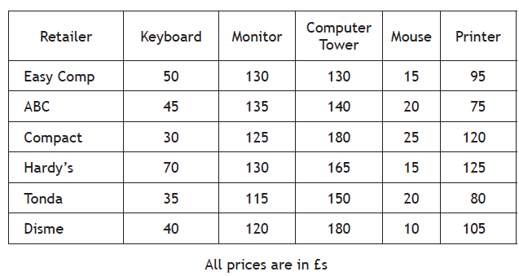
National 5 Applications of Maths
Budgeting
Budgeting Questions
Example 2: Fraser is going to buy a new computer system. He researches different retailers.
How much would the computer cost if Fraser bought everything from Tonda?

Slide 7
National 5 Applications of Maths
Budgeting
Budgeting Questions
Example 2: Fraser is going to buy a new computer system. He researches different retailers.
b) Fraser pays for the TV with the following method.
30% of the money up front.
9 payments of £35
How much more did Fraser pay for the computer with this method.

Slide 8
National 5 Applications of Maths
Budgeting
Budgeting Questions
Example 3: Euan earns £10.50 an hour, and works 50 hours a week
a) Calculate how much Euan makes in a week.

Slide 9
National 5 Applications of Maths
Budgeting
Budgeting Questions
Example 3: Euan’s outgoings are shown on the following table.
b) Calculate how much money Euan has after all these outgoings.
Food | £35
Electricity | £12
Entertainment | £18
Rent | £90
Going Out | £40
Clothes | £50

Slide 10
National 5 Applications of Maths
Budgeting
Budgeting Questions
Example 3: Euan’s decides to save half the money he has left so he can go on a holiday in 6 months.
Euan can see three package deals for his holiday for the following prices.
c) What is the most expensive package that Euan can afford?
Package A | £750
Package B | £890
Package C | £1100

