Slide 1
Higher Applications of Mathematics
Higher Applications: Statistics Unit

Slide 2
Higher Applications of Mathematics
Higher Applications: Statistics Unit

Slide 3
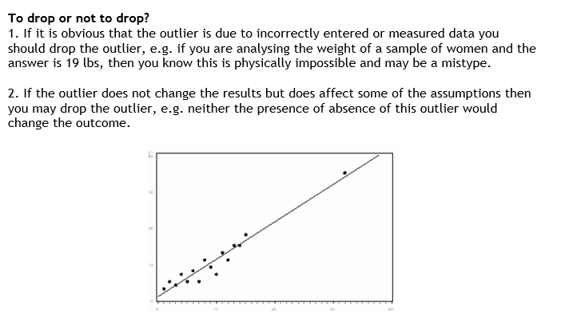
Higher Applications of Mathematics
Higher Applications: Statistics Unit

Slide 4
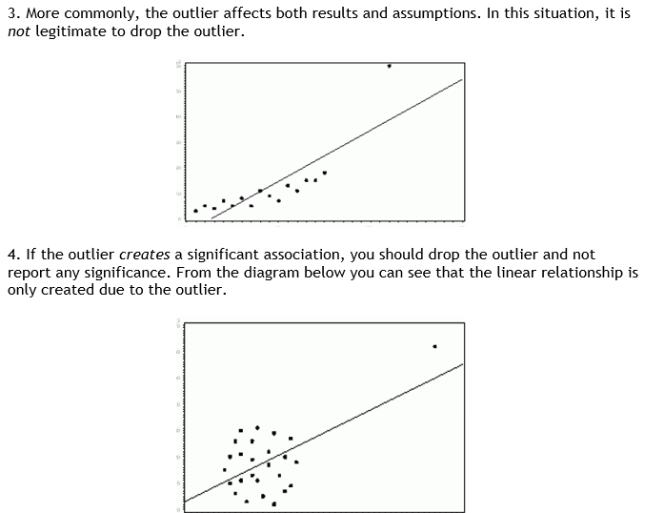
Higher Applications of Mathematics
Higher Applications: Statistics Unit

Slide 5
Higher Applications of Mathematics
Higher Applications: Statistics Unit

Slide 6
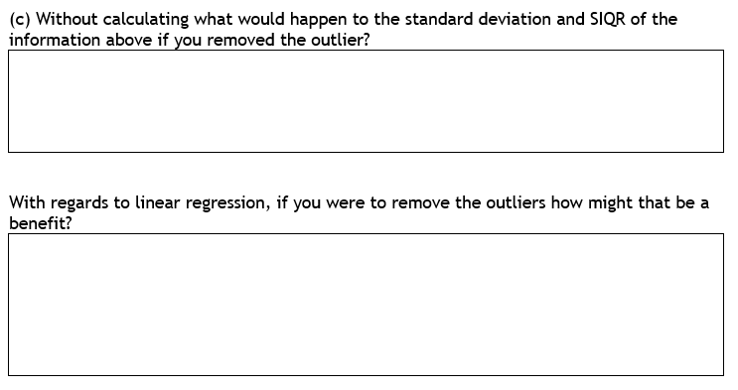
Higher Applications of Mathematics
Higher Applications: Statistics Unit

