Slide 1
Higher Applications of Mathematics
Higher Applications: Statistics Unit

Slide 2
Higher Applications of Mathematics
Higher Applications: Statistics Unit

Slide 3
Higher Applications of Mathematics
Higher Applications: Statistics Unit

Slide 4
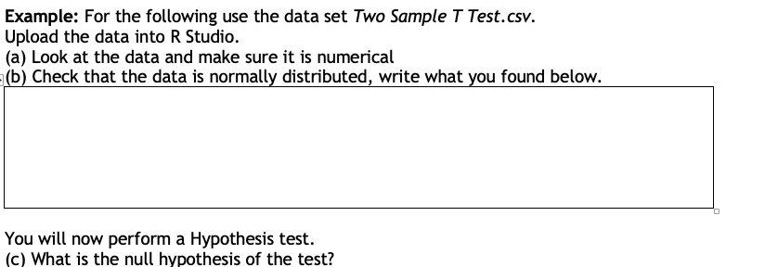
Higher Applications of Mathematics
Higher Applications: Statistics Unit

Slide 5
Higher Applications of Mathematics
Higher Applications: Statistics Unit

Slide 6
Higher Applications of Mathematics
Higher Applications: Statistics Unit

Slide 7
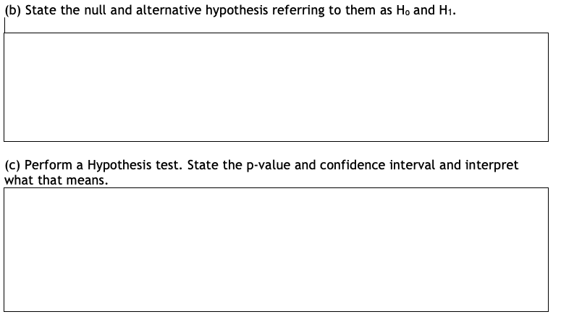
Higher Applications of Mathematics
Higher Applications: Statistics Unit

Slide 8
Higher Applications of Mathematics
Higher Applications: Statistics Unit
Try this question yourself - Hypothesis T Testing
A researcher is trying to see if birds who are raised in captivity live longer than those who live in the wild.
(a) State a null and alternative hypothesis for this.
(b) Using the data set wildvscaptivity, why it is appropriate to use a t test.
(c) Perform a t test and state the p value and the 95% confidence intervals for the difference of the means.
(d) Interpret the result.

Slide 9
Higher Applications of Mathematics
Higher Applications: Statistics Unit

Slide 10
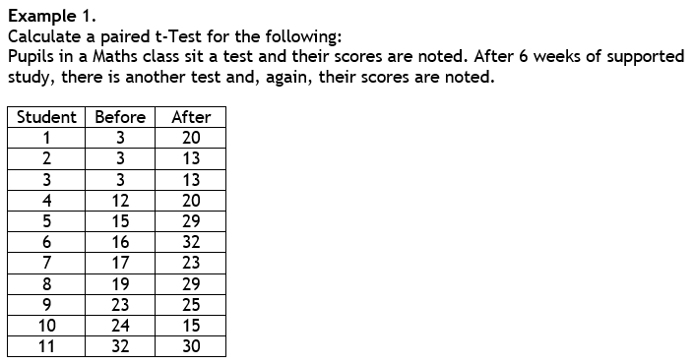
Higher Applications of Mathematics
Higher Applications: Statistics Unit

Slide 11
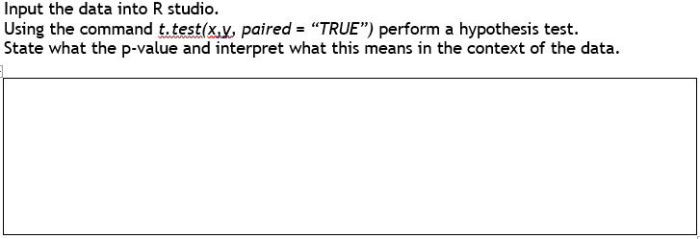
Higher Applications of Mathematics
Higher Applications: Statistics Unit

Slide 12
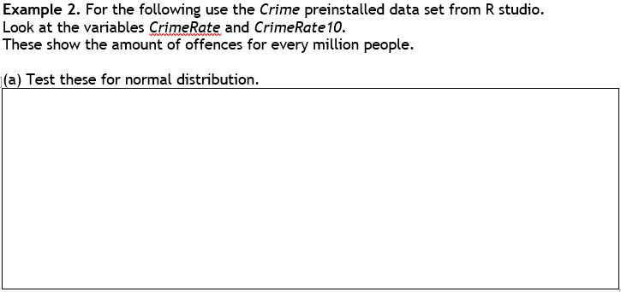
Higher Applications of Mathematics
Higher Applications: Statistics Unit

Slide 13
Higher Applications of Mathematics
Higher Applications: Statistics Unit

Slide 14
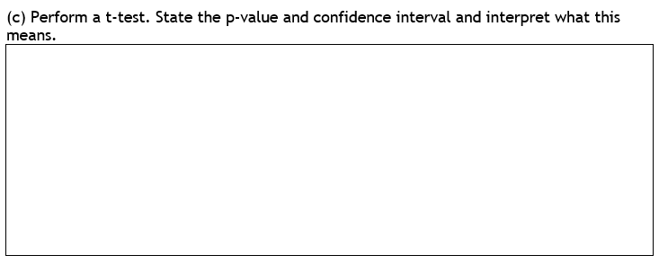
Higher Applications of Mathematics
Higher Applications: Statistics Unit

Slide 15
Higher Applications of Mathematics
Higher Applications: Statistics Unit
The following data set attendance.csv shows pupils attendance throughout their time in S3 and S4.
State the null and alternative hypothesis
Assuming the data is normally distributed would it require a Two Sample T Test or a Paired T Test?
Perform the Hypothesis Test and State the P Value
Interpret that result.

Slide 16
Higher Applications of Mathematics
Higher Applications: Statistics Unit

Slide 17
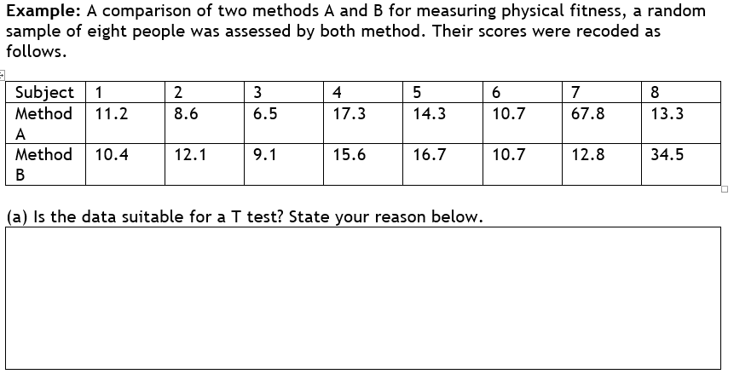
Higher Applications of Mathematics
Higher Applications: Statistics Unit

Slide 18
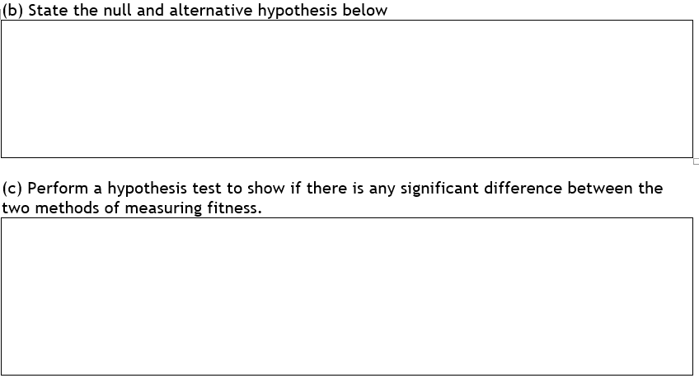
Higher Applications of Mathematics
Higher Applications: Statistics Unit

Slide 19
Higher Applications of Mathematics
Higher Applications: Statistics Unit
Question: Two drugs are being trialled. Using a series of criteria such as “are they experiencing headaches” etc
, patients are given what is called their pain scores.
The higher the number the more pain they are in. It is socred out of 10.
Drug A | 4.3 2.5 1.8 5.7 1.9 3.4 1.4 3.5 6.2 9.4 9.2 2.7 2.9
Drug B | 1.6 1.9 3.4 5.1 2.6 4.6 3.8 3.9 4.5 5.2 4.6 4.9 8.7
State the null and alternative hypothesis
Show that it would not be appropriate to use a t test and explain your reasoning.
Perform a Hypothesis Tests and Interpret your results.

Slide 20
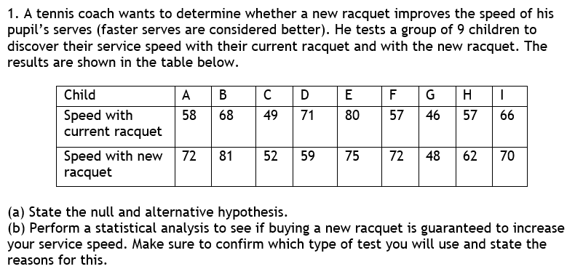
Higher Applications of Mathematics
Higher Applications: Statistics Unit

Slide 21
Higher Applications of Mathematics
Higher Applications: Statistics Unit

Slide 22
Higher Applications of Mathematics
Higher Applications: Statistics Unit
Starter
1. The following table shows the amount of goals a team concedes on a dry and wet days. They want to see if they concede more goals in dry days than wet days
Dry | 1 | 0 | 0 | 4 | 2 | 0 | 1 | 2 | 2 | 3 | 1 | 0 | 2
Wet | 1 | 1 | 1 | 0 | 0 | 3 | 0 | 1 | 0 | 3 | 4
State the null and alternative hypothesis
Figure out which kind of test to do, should it be paired or unpaired?
Perform the hypothesis test and interpret the result.

Slide 23
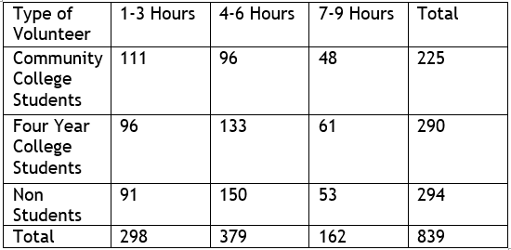
Higher Applications of Mathematics
Higher Applications: Statistics Unit

Slide 24
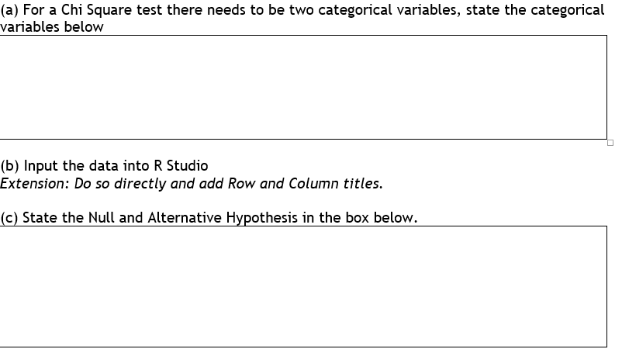
Higher Applications of Mathematics
Higher Applications: Statistics Unit

Slide 25
Higher Applications of Mathematics
Higher Applications: Statistics Unit

Slide 26
Higher Applications of Mathematics
Higher Applications: Statistics Unit

Slide 27
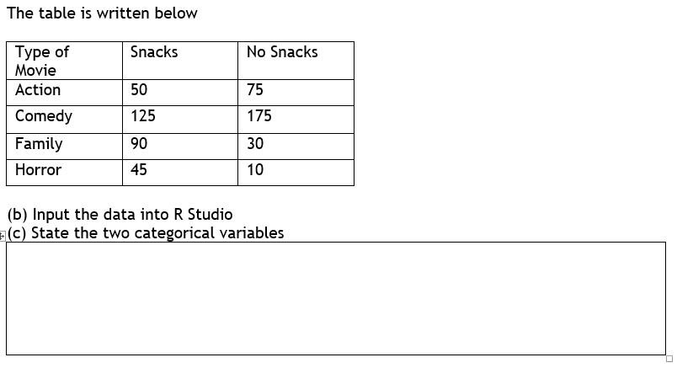
Higher Applications of Mathematics
Higher Applications: Statistics Unit

Slide 28
Higher Applications of Mathematics
Higher Applications: Statistics Unit

Slide 29
Higher Applications of Mathematics
Higher Applications: Statistics Unit
The following table shows players of different heights and position they play in a Amateur football league.
 | 5’8 or under | Between 5’9 add 6’2 | 6’3 or over
Goalkeeper | 2 | 16 | 14
Defender | 28 | 41 | 13
Midfielder | 31 | 86 | 5
Forwards | 29 | 42 | 10
State the categorical variables involved in this table.
State the null and alternative hypothesis.
Input the data into R studio with row and column names.
Perform a statistical test to test the relationship between them.

Slide 30
Higher Applications of Mathematics
Higher Applications: Statistics Unit
Two pizza companies are comparing their delivery times to see if one is better than the other.
Use the file Pizza.csv
State variables involved in this table.
State the null and alternative hypothesis.
State is the data is normally distributed.
Perform a statistical test to test the relationship between them.

Slide 31
Higher Applications of Mathematics
Higher Applications: Statistics Unit

Slide 32
Higher Applications of Mathematics
Higher Applications: Statistics Unit

Slide 33
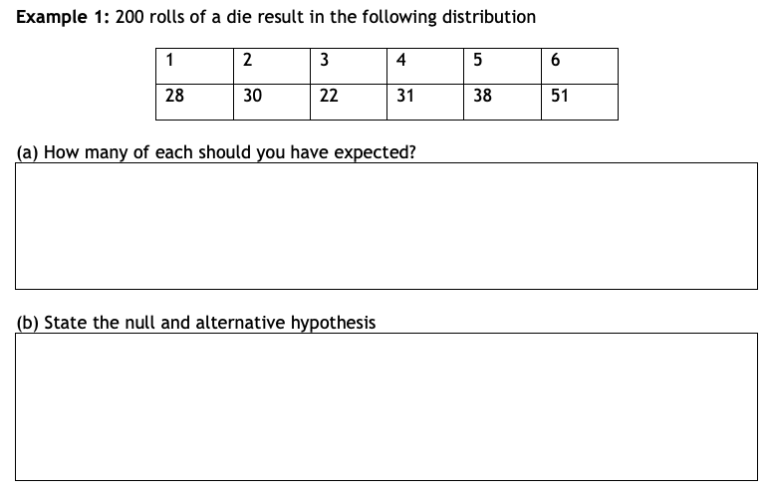
Higher Applications of Mathematics
Higher Applications: Statistics Unit

Slide 34
Higher Applications of Mathematics
Higher Applications: Statistics Unit

Slide 35
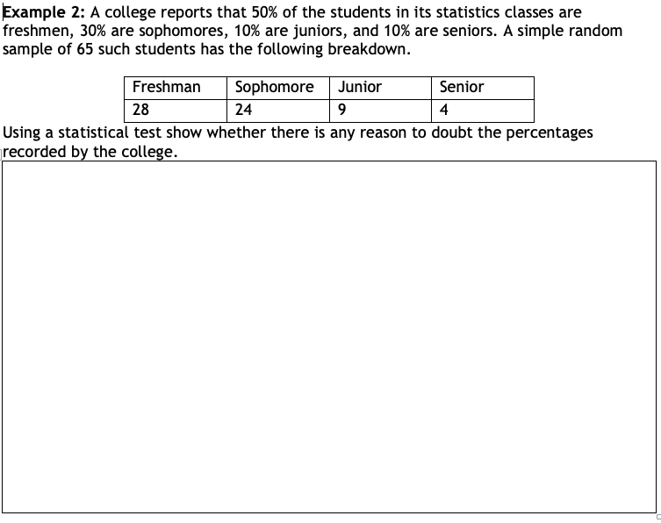
Higher Applications of Mathematics
Higher Applications: Statistics Unit

Slide 36
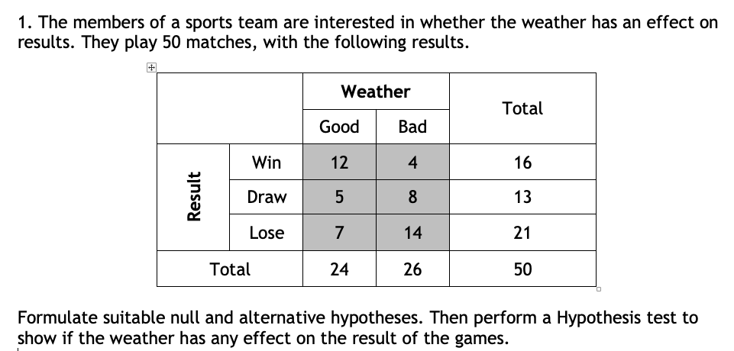
Higher Applications of Mathematics
Higher Applications: Statistics Unit

Slide 37
Higher Applications of Mathematics
Higher Applications: Statistics Unit

Slide 38
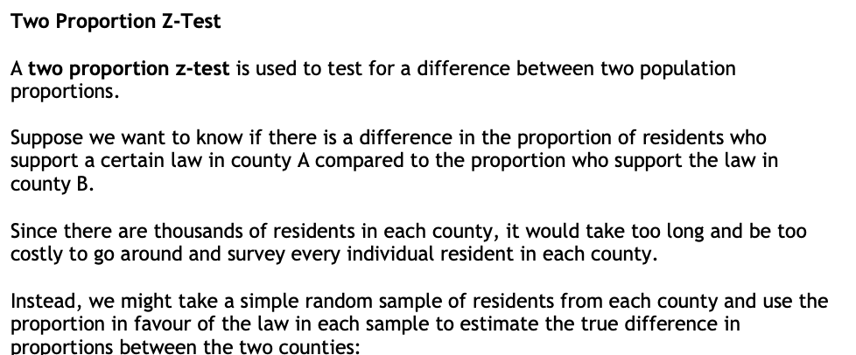
Higher Applications of Mathematics
Higher Applications: Statistics Unit

Slide 39
Higher Applications of Mathematics
Higher Applications: Statistics Unit

Slide 40
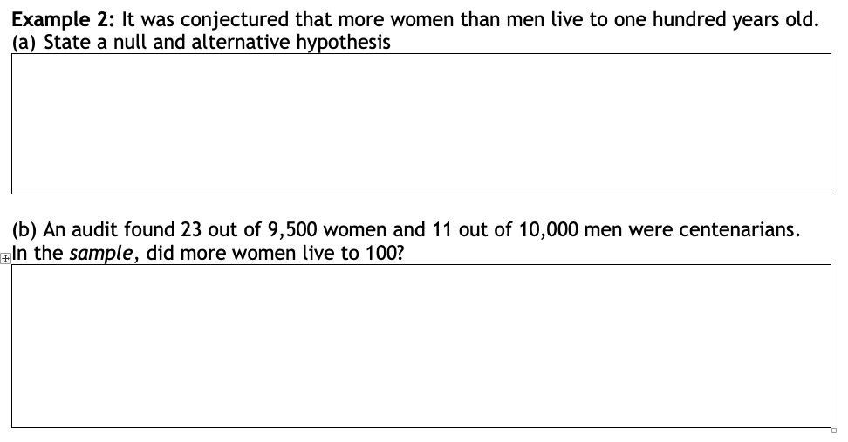
Higher Applications of Mathematics
Higher Applications: Statistics Unit

Slide 41
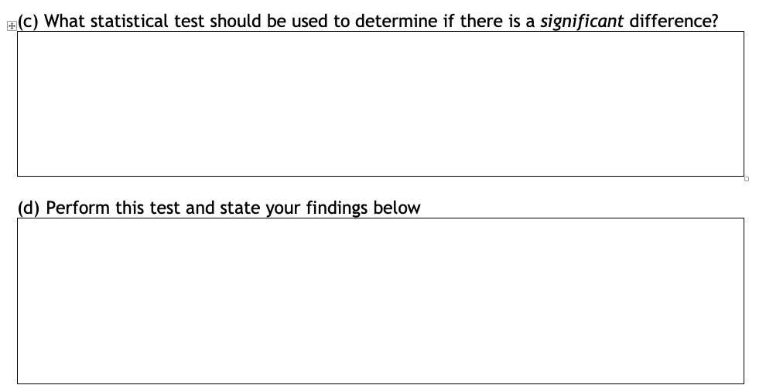
Higher Applications of Mathematics
Higher Applications: Statistics Unit

