Slide 1
National 5 Applications of Maths
Proability
Calculating Probability
Expected Probability
Exam Questions

Slide 2
National 5 Applications of Maths
Probability
Basic Probability
Probability is the chance of something happening, the formula to work it out is,
$$Probability= \frac{Total number of desired outcomes}{Total number of outcomes}$$
$$÷$$

Slide 3
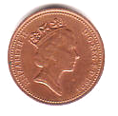
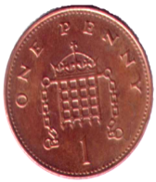
National 5 Applications of Maths
Probability
Example 1:
Tony tosses a coin. What is the probability of him getting heads.
$$Probability= \frac{Total number of desired outcomes}{Total number of outcomes}$$
1
=
=
2

Slide 4
National 5 Applications of Maths
Probability
Example 2:
Amy rolls a dice that has 6 faces, what is the probability of her getting a 4?

Slide 5
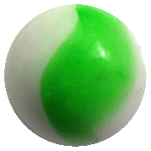
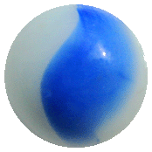
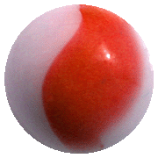
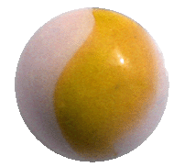
National 5 Applications of Maths
Probability
Example 3: A bag contains 1 yellow, 3 green, 4 blue and 2 red marbles.
What is the probability of pulling a green marble from the bag without looking?
*P(green) means, the probability of getting a green.

Slide 6
National 5 Applications of Maths
Probability
Questions
In a bag, there are 5 red marbles, 3 blue, 4 yellow and 7 black.
What is the probability of picking
A red marble
A blue or yellow marble
Not picking a black marble.
What is the probability of picking a red card in a pack of cards?
Picking a 4 in a pack of cards.

Slide 7
National 5 Applications of Maths
Probability
Questions
In a bag, there are 5 red marbles, 3 blue, 4 yellow and 7 black.
What is the probability of picking
A red marble
A blue or yellow marble
Not picking a black one.
What is the probability of picking a red card in a pack of cards?
Picking a 4 in a pack of cards.
Answers
a) $\frac{5}{19}$
b) $\frac{7}{19}$
c) $\frac{12}{19}$
d) $\frac{1}{2}$
e) $\frac{1}{13}$

Slide 8
National 5 Applications of Maths
Probability
Expected success is the amount of times that you would expect something to happen.
For example if you flip a coin twice, how many times would you expect to get a heads?
If you flipped a coin 20 times, how many times would you expect to get tails?
This is expected success.

Slide 9
National 5 Applications of Maths
Probability
Example 1:
It you were to roll a dice, how many times would you expect to get a 3 if you rolled it…
a) 240 times b) 420 times c) 3000 times

Slide 10
National 5 Applications of Maths
Probability
Example 2:
In a country in Europe it is expected that it will rain 3 in every 10 days. How many times would you expect it to rain in,
a) 30 days b) 100 days c) a year

Slide 11
National 5 Applications of Maths
Probability
Example 3:
A group of pupils were asked what their favourite sport was, their answers are below.
Sport | Football | Rugby | Basketball | Tennis | Netball
Freq. | 12 | 4 | 6 | 8 | 10
a) What is the probability the next pupil asked in the school’s favourite sport is
i) Football ii) Rugby iii) Basketball iv) Tennis v) Netball

Slide 12
National 5 Applications of Maths
Probability
Example 3:
A group of pupils were asked what their favourite sport was, their answers are below.
Sport | Football | Rugby | Basketball | Tennis | Netball
Freq. | 12 | 4 | 6 | 8 | 10
b) If 80 pupils were asked, how many would you expect to say each sport?

Slide 13
National 5 Applications of Maths
Probability
Example 3:
A group of pupils were asked what their favourite sport was, their answers are below.
Sport | Football | Rugby | Basketball | Tennis | Netball
Freq. | 12 | 4 | 6 | 8 | 10
c) If There are 1600 pupils in the school, give your estimate for the final results.

Slide 14
National 5 Applications of Maths
Probability
Exam Questions
Example 1: In a game where you roll two dice and add the scores you only win if you get a number below 4, what is the probability of winning the game?

Slide 15
National 5 Applications of Maths
Probability
Exam Questions
Example 2: A class is split up into girls and boys then asked what their first pet was, the results are listed below.
 | Cat | Dog | Fish | Rabbit
Boys | 4 | 7 | 1 | 1
Girls | 4 | 6 | 1 | 2
a) What is the probability that a pupil picked at random is a Girl who has a Dog.

Slide 16
National 5 Applications of Maths
Probability
Exam Questions
Example 2: A class is split up into girls and boys then asked what their first pet was, the results are listed below.
 | Cat | Dog | Fish | Rabbit
Boys | 4 | 7 | 1 | 1
Girls | 4 | 6 | 1 | 2
b) What is the probability that a boy picked at random has a cat?

Slide 17
National 5 Applications of Maths
Probability
Exam Questions
Example 3: In a game, you flip a coin and spin a a dial with the numbers 1 to 8 on it. You only win if you gets heads of a coin and roll an even number on the dice.
What is the probability of winning the game?

