Slide 1
Higher Applications of Mathematics
Higher Applications: Statistics Unit

Slide 2
Higher Applications of Mathematics
Higher Applications: Statistics Unit

Slide 3
Higher Applications of Mathematics
Higher Applications: Statistics Unit

Slide 4
Higher Applications of Mathematics
Higher Applications: Statistics Unit

Slide 5
Higher Applications of Mathematics
Higher Applications: Statistics Unit

Slide 6
Higher Applications of Mathematics
Higher Applications: Statistics Unit

Slide 7
Higher Applications of Mathematics
Higher Applications: Statistics Unit

Slide 8
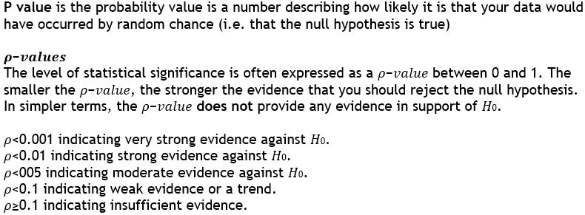
Higher Applications of Mathematics
Higher Applications: Statistics Unit

Slide 9
Higher Applications of Mathematics
Higher Applications: Statistics Unit

Slide 10
Higher Applications of Mathematics
Higher Applications: Statistics Unit

Slide 11
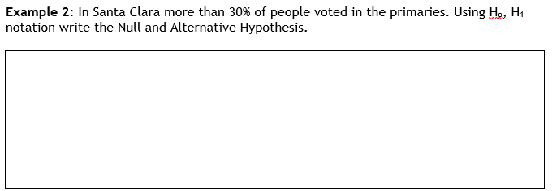
Higher Applications of Mathematics
Higher Applications: Statistics Unit

Slide 12
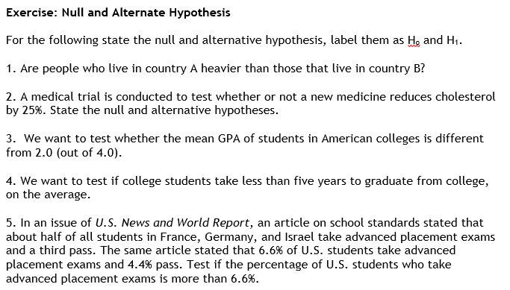
Higher Applications of Mathematics
Higher Applications: Statistics Unit

