Slide 1
Higher Applications of Mathematics
Higher Applications: Statistics Unit
Numerical Representations.
From National 5 Mathematics and Applications of Mathematics you will have encountered a few numerical statistics
Measures of Location (Average) – Mean, mode and median
Measures of Spread – Standard Deviation, SIQR and IQR.

Slide 2
Higher Applications of Mathematics
Higher Applications: Statistics Unit
Example 1: Calculate the mean and median of the following test scores from Mr Williams’ class.
45 81 29 10 26 38 40 28 77 63 90
A pupil was absent from the class. What would happen to the average if the person scored 52, would the average go up or down?
Mrs Davis’s class has an average score of 62. Make a comparison between the two classes.

Slide 3
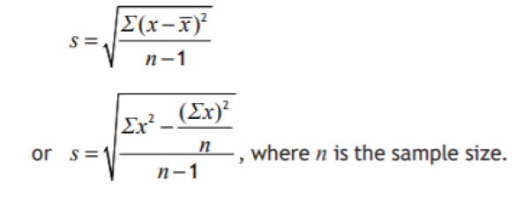
Higher Applications of Mathematics
Higher Applications: Statistics Unit
Example 2. Calculate the mean and standard deviation of the following
24 62 36 48 51 37

Slide 4
Higher Applications of Mathematics
Higher Applications: Statistics Unit
Example 3: Calculate the median and SIQR of the following
19 38 23 20 36 45 50 20 24 37 54

Slide 5
Higher Applications of Mathematics
Higher Applications: Statistics Unit
Example 4: Look at table below showing marks obtained in a test for 88 pupils.
Find an estimate for the mean and standard deviation
Marks | $$0≤x<10$$ | $$10≤x<20$$ | $$20≤x<30$$ | $$30≤x<40$$ | $$40≤x<50$$
Frequency | 6 | 16 | 24 | 25 | 17

