Slide 1
PRESS F5 TO START
This presentation contains National 5 past paper questions complete with solutions.
The questions are sorted into topics based on the National 5 course.
To access a particular question from the main grid just simply click on the question number.
To begin click on Main Grid.
Main Grid

Slide 2
Topic | AQA 2016 |  |  |  | AQA 2017 |  |  |  | AQA 2018 |  |  |  | AQA 2019 |  |  |  | Speciman Papers
 | P | A | B | C | P | A | B | C | P | A | B | C | P | A | B | C | 1 | 2
Displaying Graphical Data | 1 7 |  |  | 3 | 1 7 |  |  |  | 7 |  |  |  | 1 3 8
Budgeting Profits and Loss Insurance | 2 5 |  | 6 |  | 2 10 |  |  |  | 1 |  |  |  | 2 4 6
Systematic Approximation | 3 |  |  |  | 4 |  |  |  | 4 |  |  |  | 5 |  |  |  | 1
Data/Sampling | 4 |  |  |  | 5 | 2 |  |  | 2 | 7
Wages Foreign Exchange | 6 |  |  |  | 3 8 |  |  |  | 8 | 2 |  |  | 7 |  |  |  |  | 7
Loans/Insurance | 8 |  |  |  | 6 |  |  |  | 6 |  |  |  |  |  |  |  | 2 4 6 | 4 10
Creating a Model | 9 |  |  |  |  |  |  |  | 9 |  |  |  | 9
Interpreting Statistics |  | 1 2 |  | 6 | 9 | 1 5 |  | 5 | 5 | 1 6 |  |  |  | 1 2 |  |  | 10 | 3
Normal Distribution/ Confidence Intervals |  | 3 |  |  |  | 3 6 |  |  |  | 5 |  |  |  | 4 7
Linear Regression/ Correlation |  | 4 5 |  |  |  | 4 |  |  |  | 3 4 |  |  |  | 3 5 6 |  |  | 8
Probability/Venn Diagrams |  | 6 | 4 5 |  |  |  | 4 5 6 |  |  |  | 3 4 6 7 |  |  |  | 3 4 5 6 |  | 9 | 5 8
Pert and Gantt Charts |  |  | 3 7 |  |  |  | 3 |  |  |  | 5 |  |  |  |  |  | 3 | 1
Using Models |  |  |  | 4 5 7 |  |  |  | 3 4 6 | 3 |  |  | 3 4 5 6 |  |  |  | 3 4 5 6 | 5 7 | 2 6 9

Slide 3
Topic | HAoM 2022 (No MS)
Displaying Graphical Data
Budgeting Profits and Loss Insurance
Systematic Approximation
Data/Sampling
Wages Foreign Exchange | 8
Loans/Insurance | 1 4 6* 9
Creating a Model
Interpreting Statistics | 3
Normal Distribution/ Confidence Intervals
Linear Regression/ Correlation | 7
Probability/Venn Diagrams
Pert and Gantt Charts | 2
Using Models | 5

Slide 4
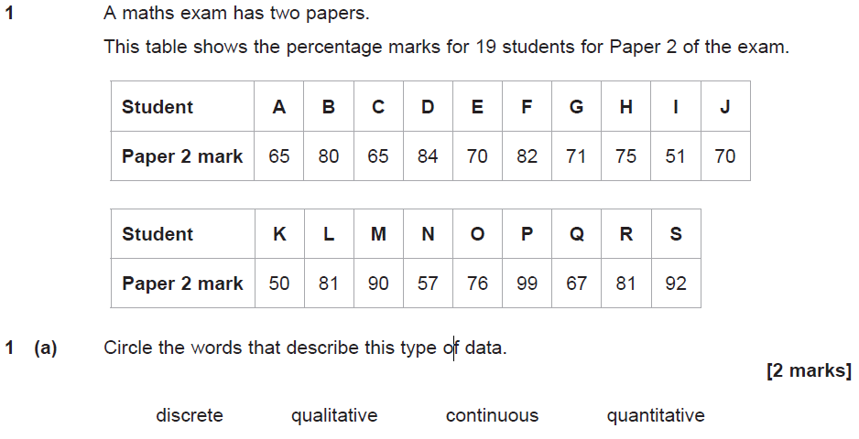
Solution
Main Grid

Slide 5
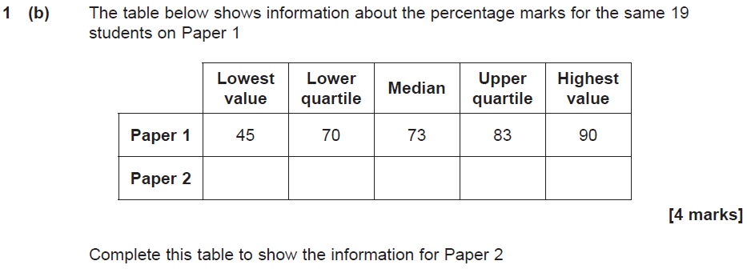
Solution
Main Grid

Slide 6
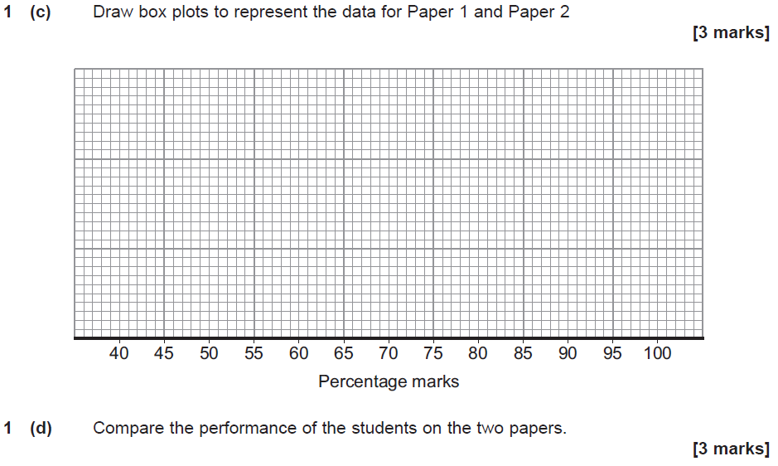
Solution
Main Grid

Slide 7
Main Grid

Slide 8
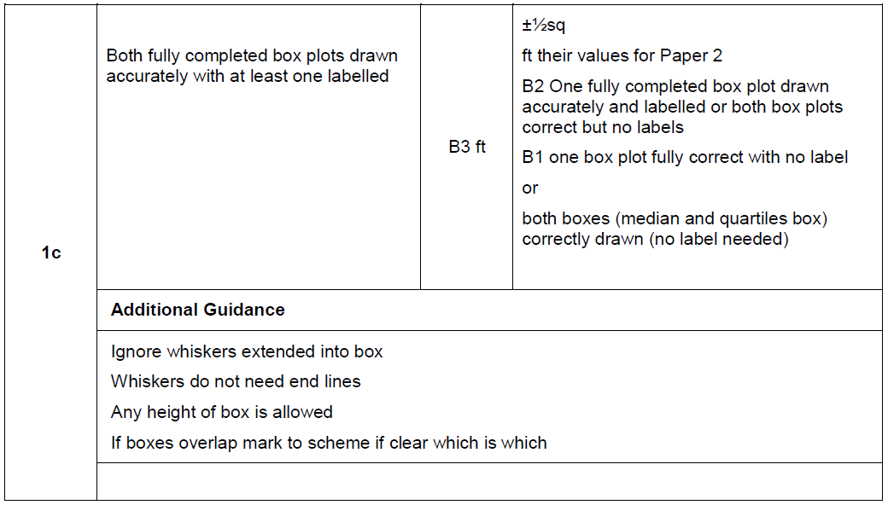
Main Grid

Slide 9
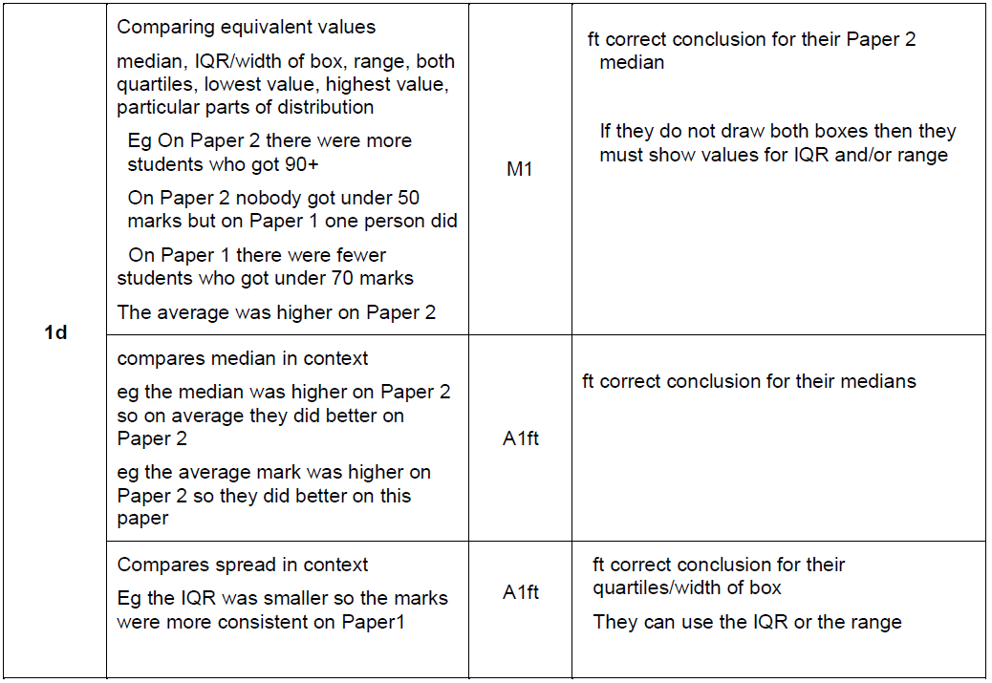
Main Grid

Slide 10
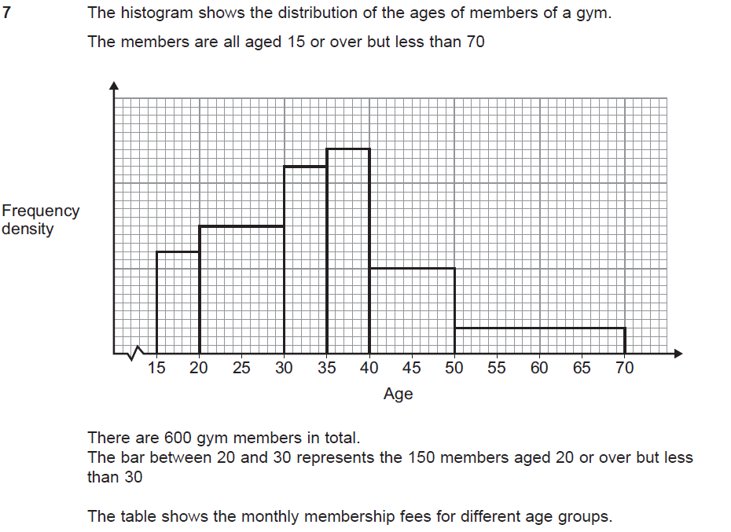
Solution
Main Grid

Slide 11
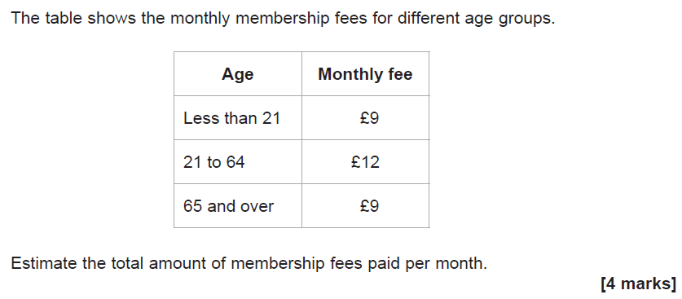
Solution
Main Grid

Slide 12
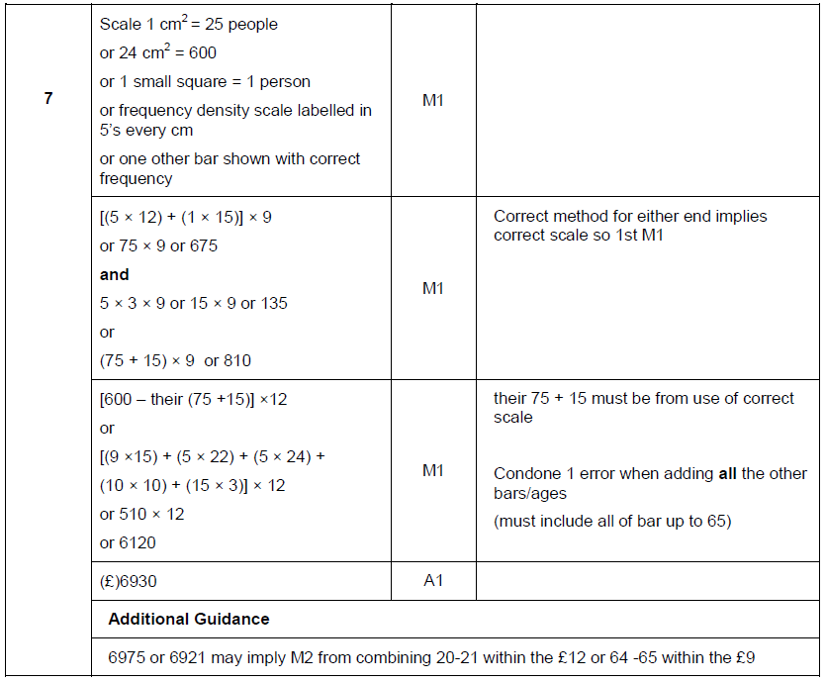
Main Grid

Slide 13
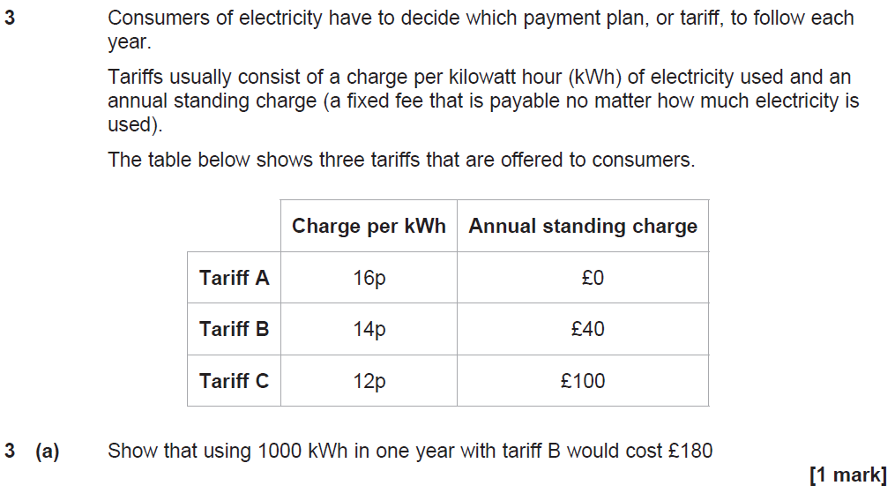
Solution
Main Grid

Slide 14
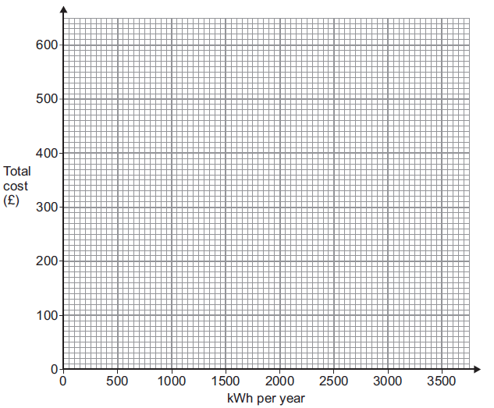
Solution
Main Grid

Slide 15
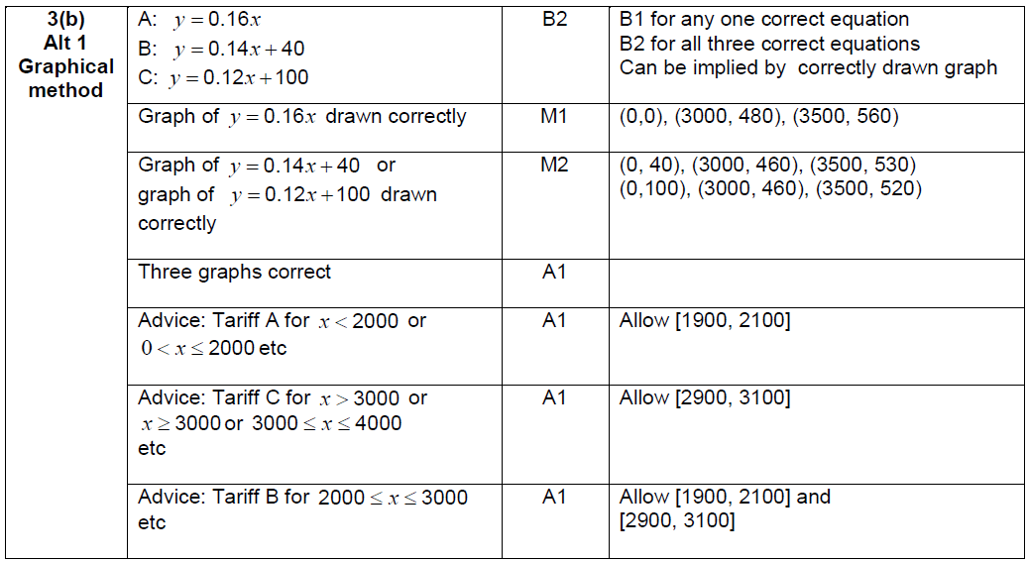
Main Grid

Slide 16
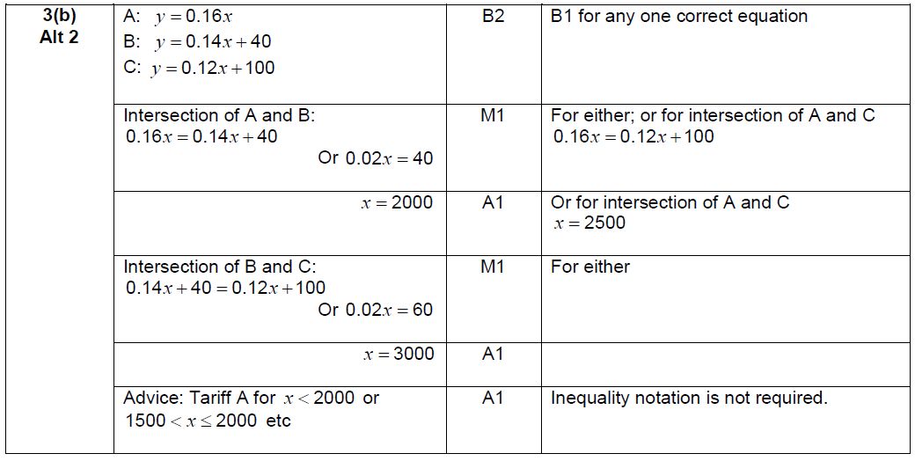
Main Grid

Slide 17
Main Grid

Slide 18
Solution
Main Grid

Slide 19
Solution
Main Grid

Slide 20
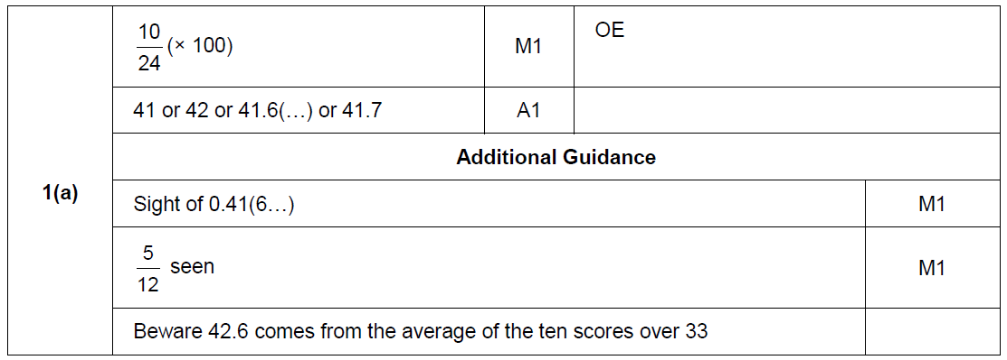
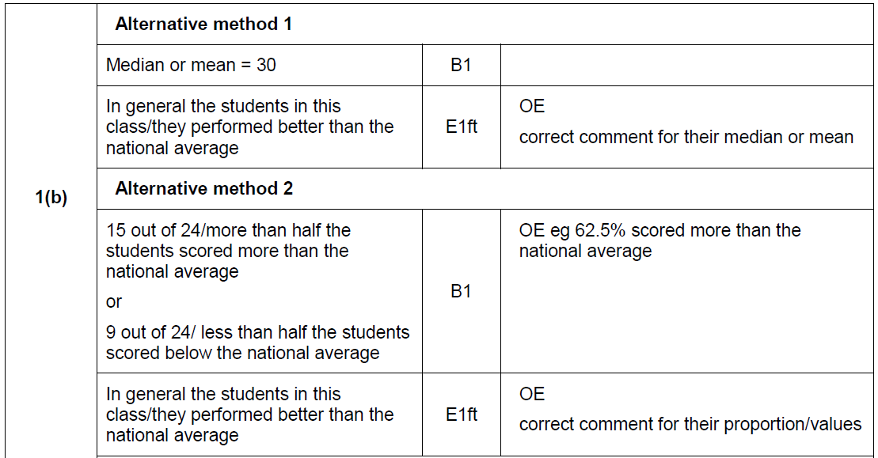
Main Grid

Slide 21
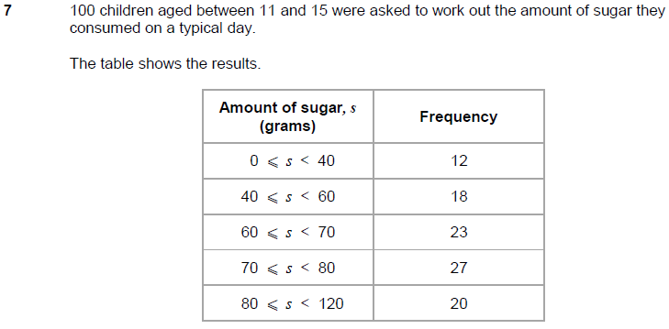
Solution
Main Grid

Slide 22
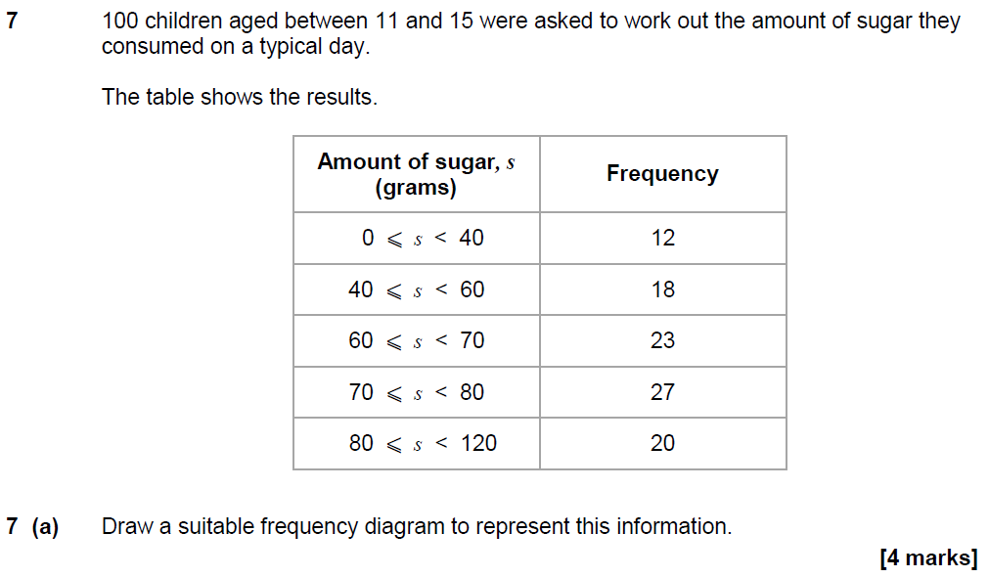
Solution
Main Grid

Slide 23
Solution
Main Grid

Slide 24
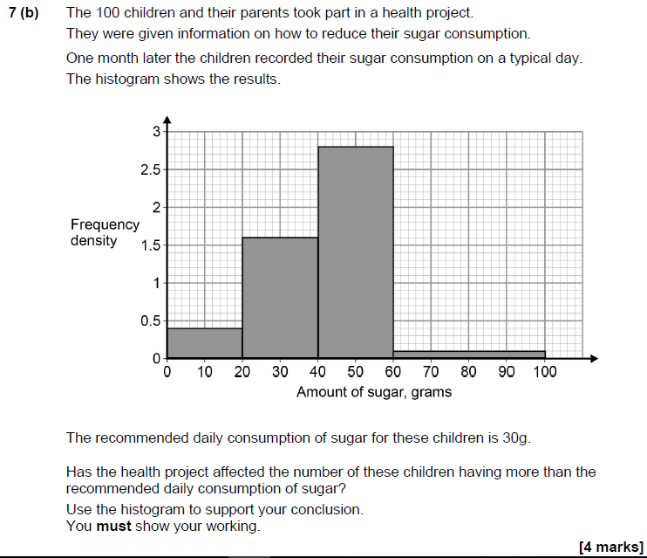
Solution
Main Grid

Slide 25
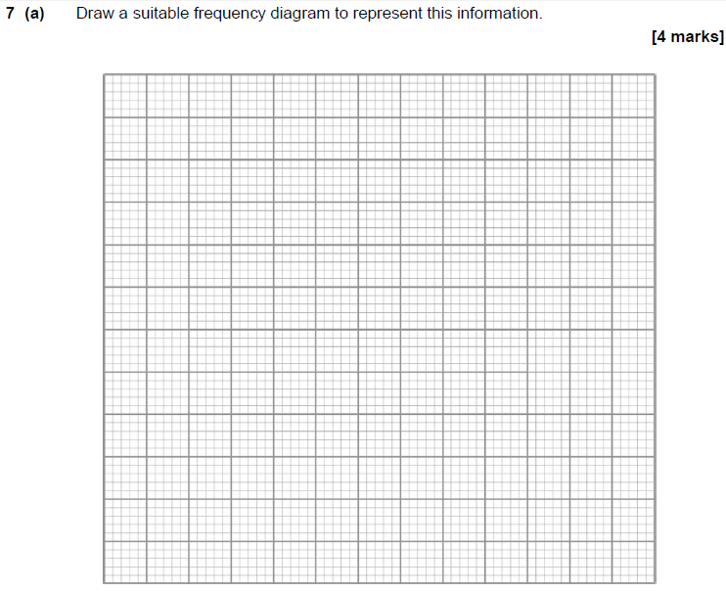
Solution
Main Grid

Slide 26
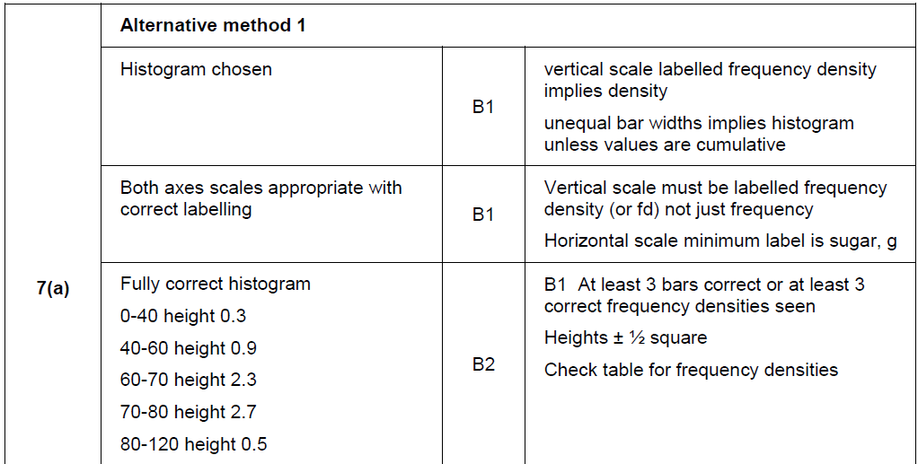
Main Grid

Slide 27
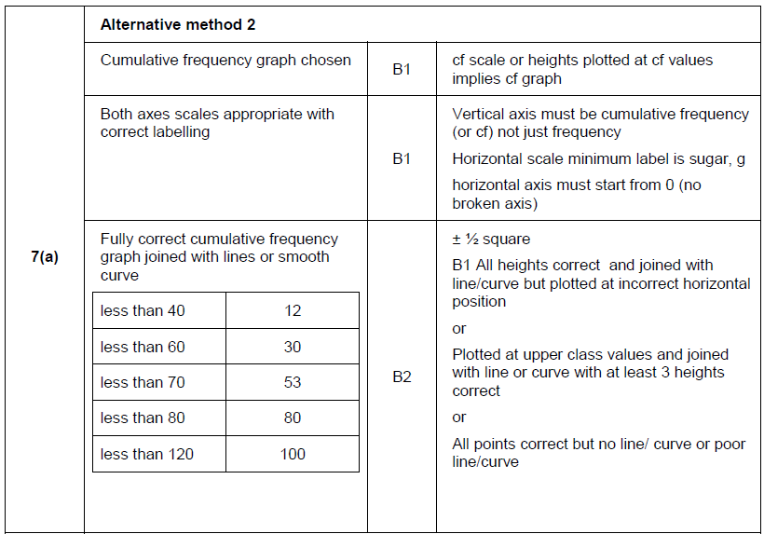
Main Grid

Slide 28
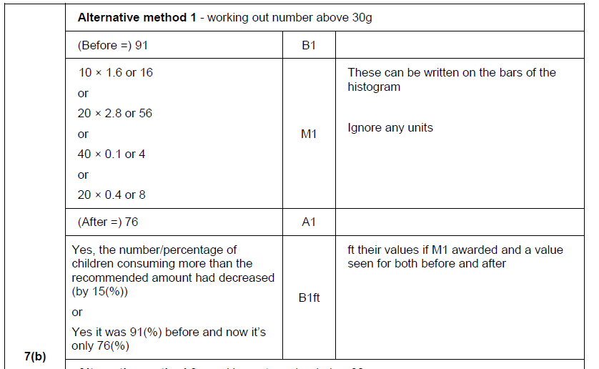
Main Grid

Slide 29
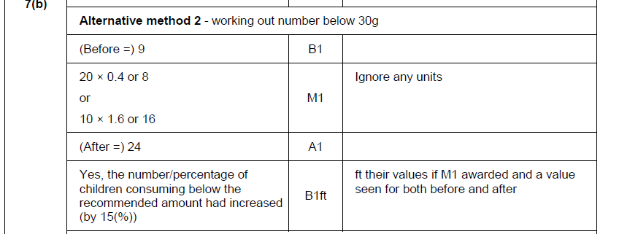
Main Grid

Slide 30
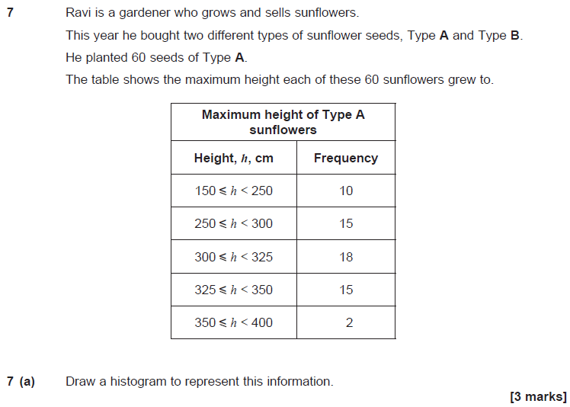
Solution
Main Grid

Slide 31
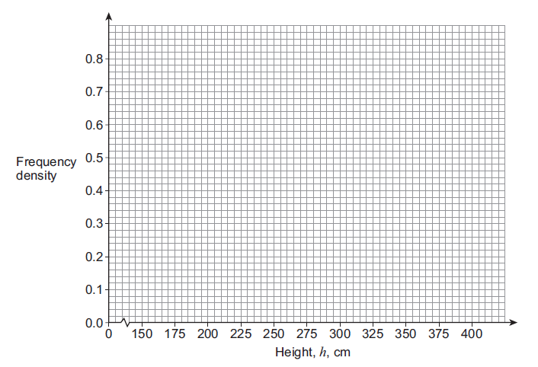
Solution
Main Grid

Slide 32
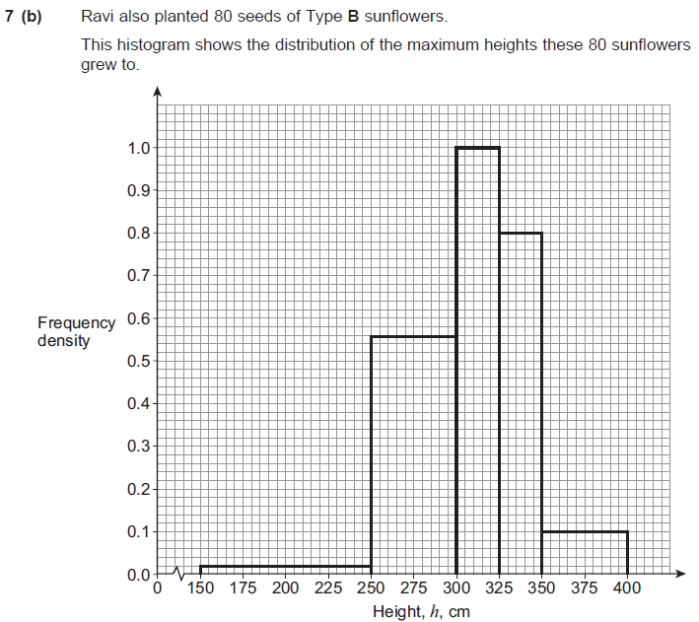
Solution
Main Grid

Slide 33
Solution
Main Grid

Slide 34
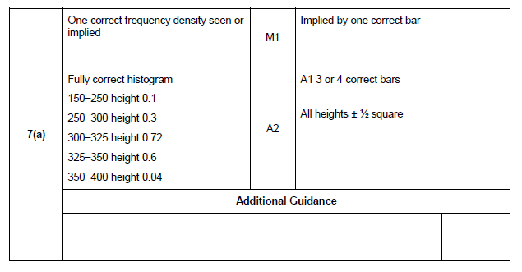
Main Grid

Slide 35
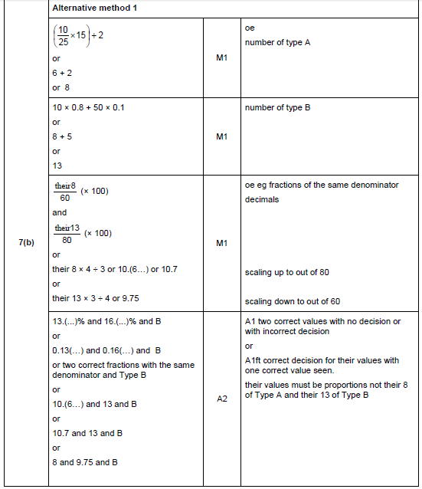
Main Grid

Slide 36
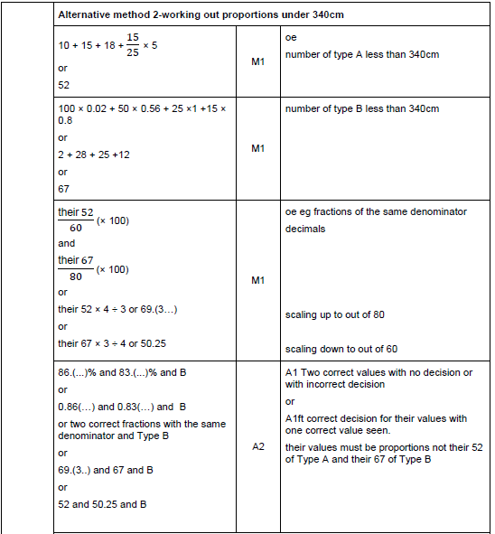
Main Grid

Slide 37
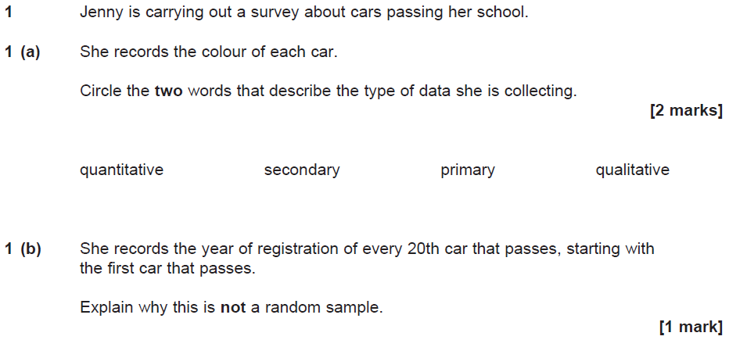
Solution
Main Grid

Slide 38
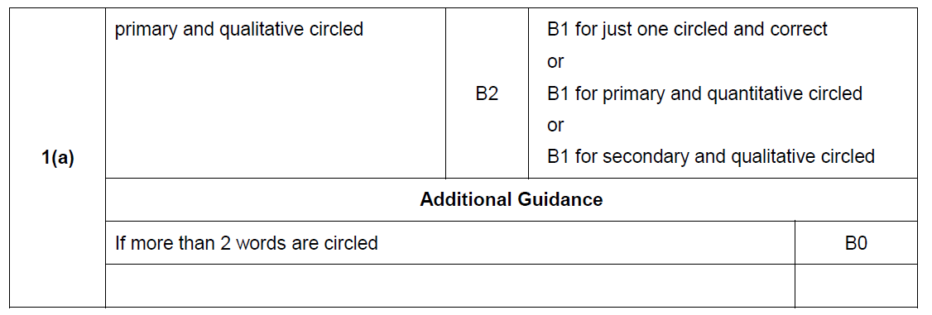
Main Grid

Slide 39
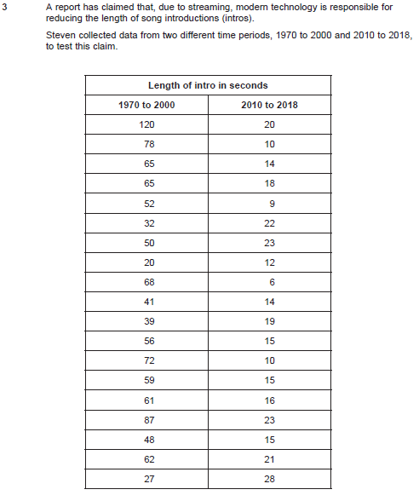
Solution
Main Grid

Slide 40
Solution
Main Grid

Slide 41
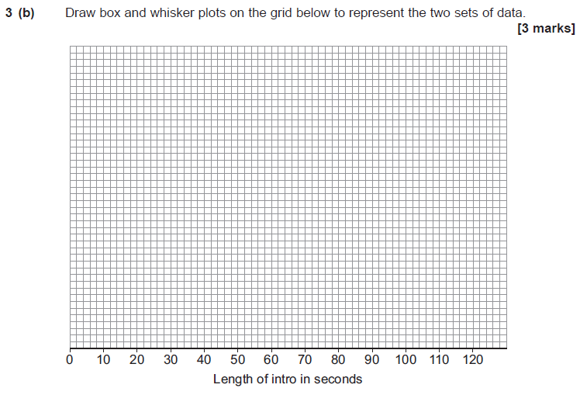
Solution
Main Grid

Slide 42
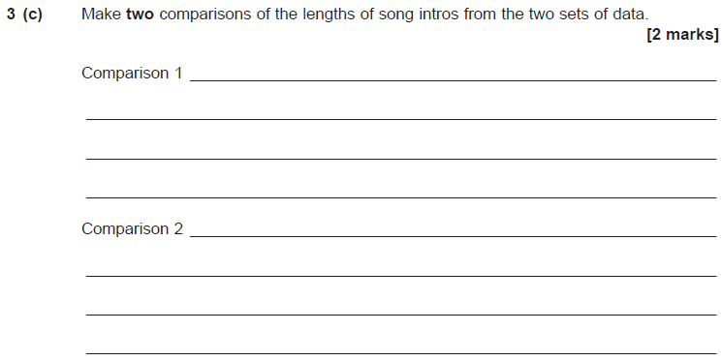
Solution
Main Grid

Slide 43
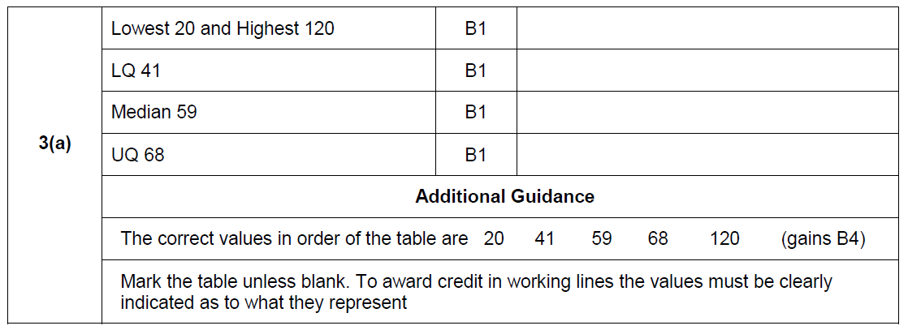
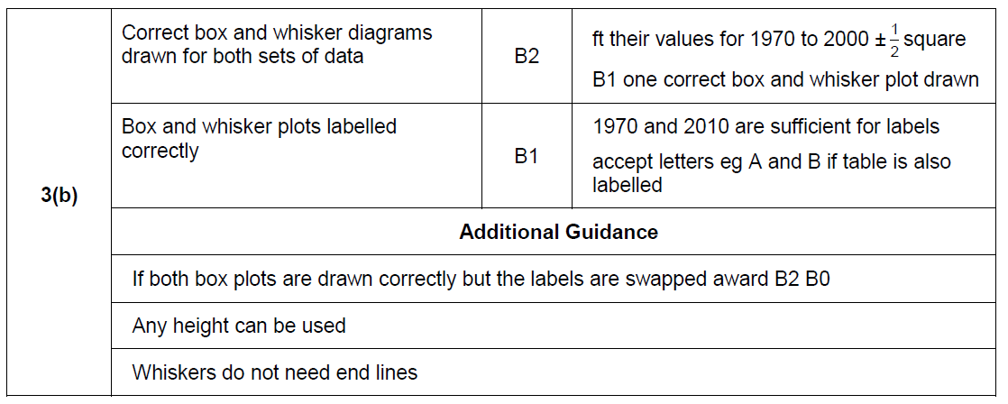
Main Grid

Slide 44
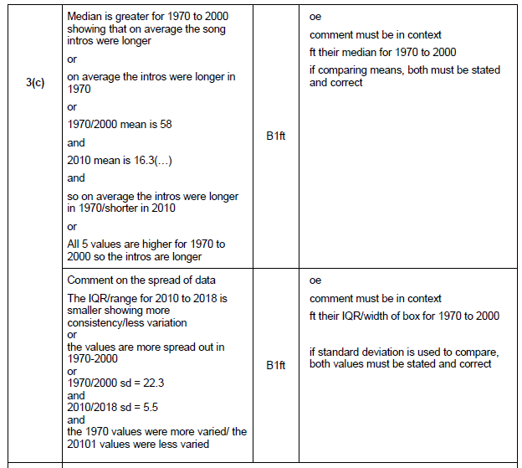
Main Grid

Slide 45
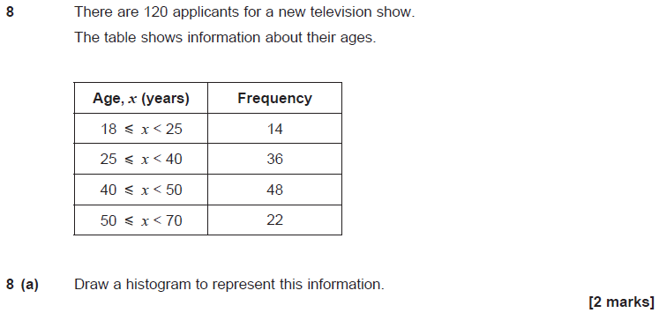
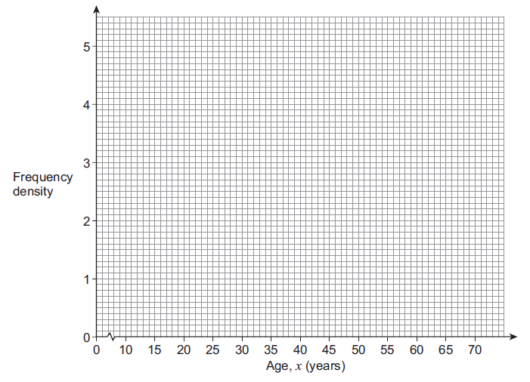
Solution
Main Grid

Slide 46
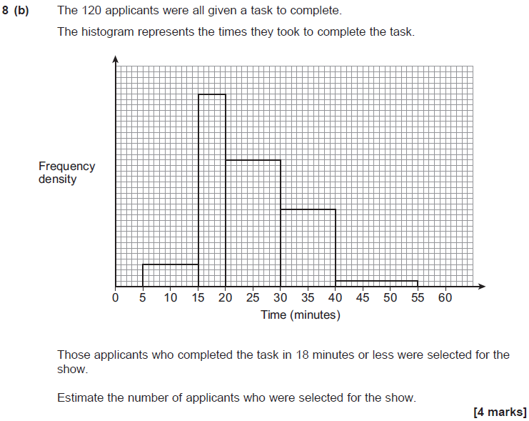
Solution
Main Grid

Slide 47
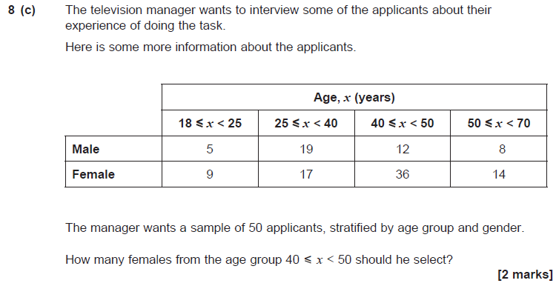
Solution
Main Grid

Slide 48
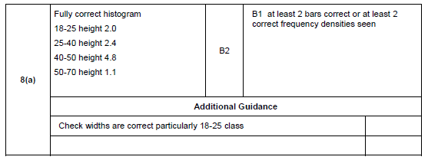
Main Grid

Slide 49
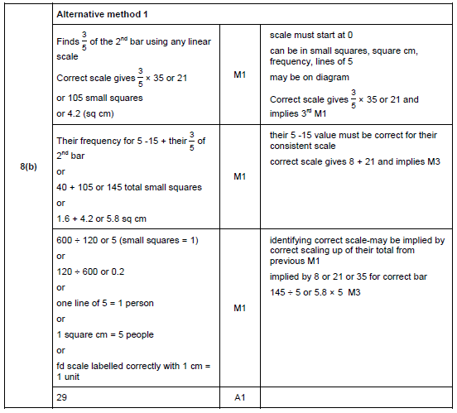
Main Grid

Slide 50
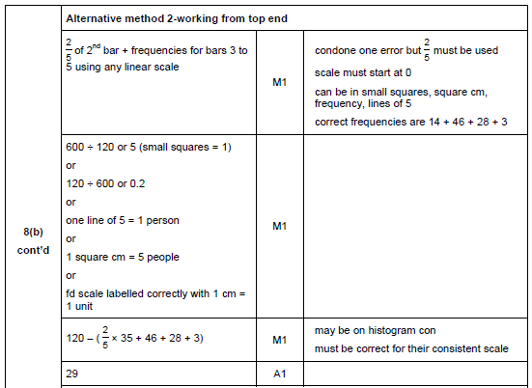
Main Grid

Slide 51
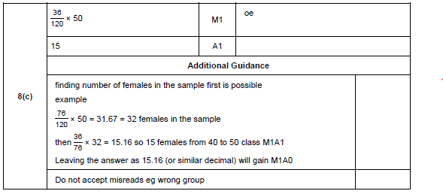
Main Grid

Slide 52
Solution
Main Grid

Slide 53
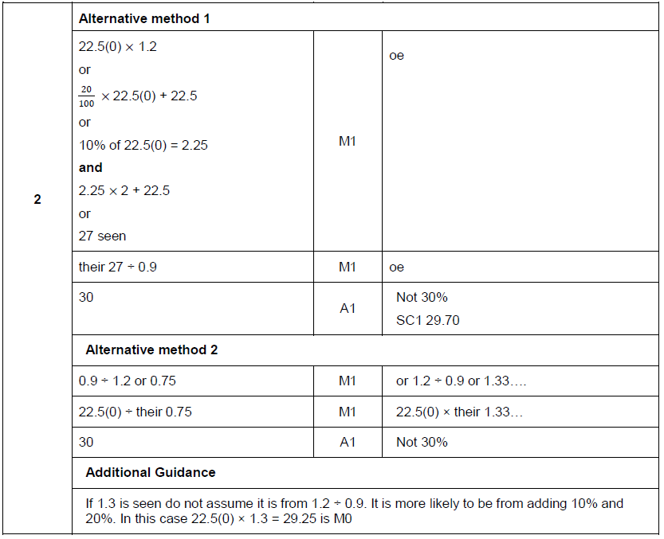
Main Grid

Slide 54
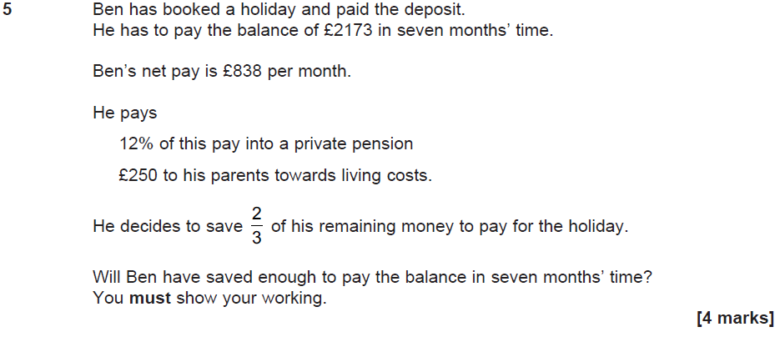
Solution
Main Grid

Slide 55
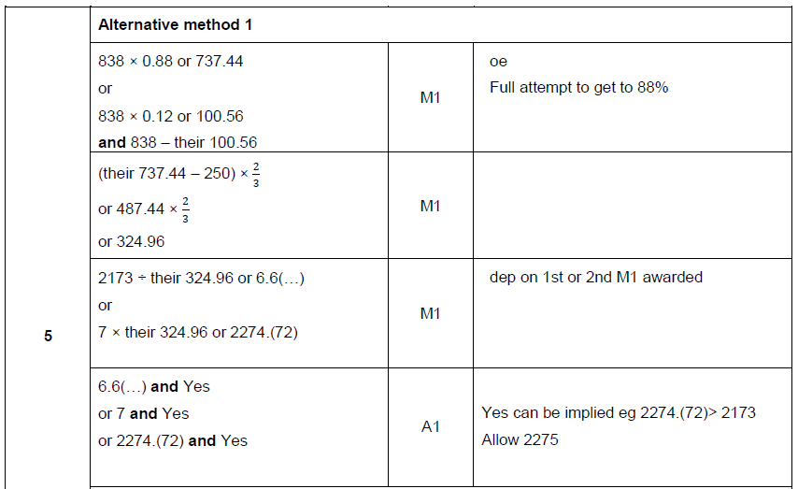
Main Grid

Slide 56
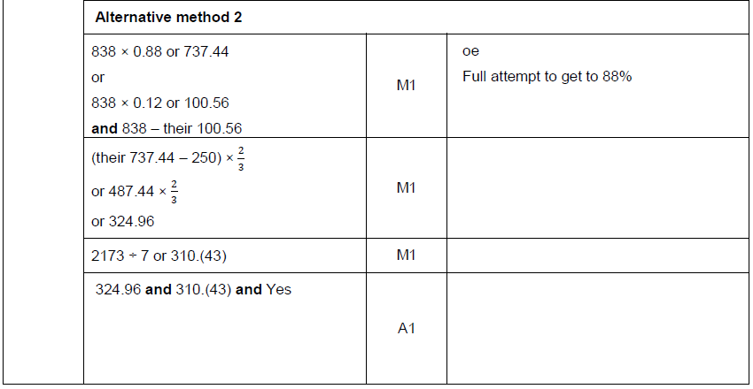
Main Grid

Slide 57
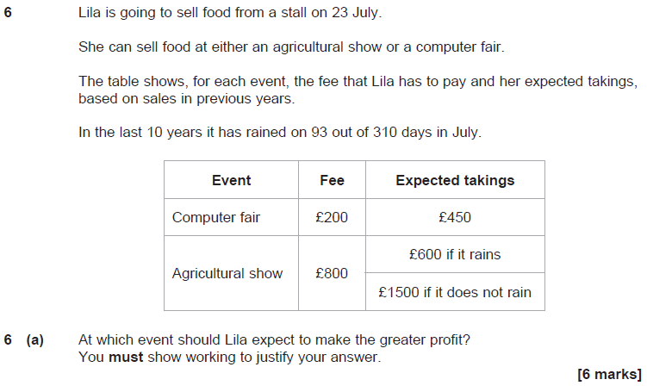
Solution
Main Grid

Slide 58
Solution
Main Grid

Slide 59
Solution
Main Grid

Slide 60
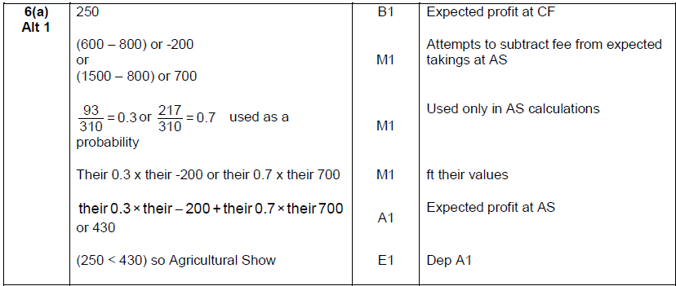
Main Grid

Slide 61
Main Grid

Slide 62
Main Grid

Slide 63
Solution
Main Grid

Slide 64
Main Grid

Slide 65
Solution
Main Grid

Slide 66
Main Grid

Slide 67
Main Grid

Slide 68
Main Grid

Slide 69
Main Grid

Slide 70
Solution
Main Grid

Slide 71
Main Grid

Slide 72
Solution
Main Grid

Slide 73
Solution
Main Grid

Slide 74
Main Grid

Slide 75
Main Grid

Slide 76
Solution
Main Grid

Slide 77
Main Grid

Slide 78
Solution
Main Grid

Slide 79
Main Grid

Slide 80
Solution
Main Grid

Slide 81
Main Grid

Slide 82
Main Grid

Slide 83
Solution
Main Grid

Slide 84
Main Grid

Slide 85
Solution
Main Grid

Slide 86
Main Grid

Slide 87
Solution
Main Grid

Slide 88
Main Grid

Slide 89
Solution
Main Grid

Slide 90
Main Grid

Slide 91
Solution
Main Grid

Slide 92
Main Grid

Slide 93
Main Grid

Slide 94
Solution
Main Grid

Slide 95
Solution
Main Grid

Slide 96
Main Grid

Slide 97
Main Grid

Slide 98
Solution
Main Grid

Slide 99
Solution
Main Grid

Slide 100
Solution
Main Grid

Slide 101
Main Grid

Slide 102
Main Grid

Slide 103
Main Grid

Slide 104
Solution
Main Grid

Slide 105
Main Grid

Slide 106
Main Grid

Slide 107
Solution
Main Grid

Slide 108
Solution
Main Grid

Slide 109
Main Grid

Slide 110
Solution
Main Grid

Slide 111
Main Grid

Slide 112
Main Grid

Slide 113
Solution
Main Grid

Slide 114
Main Grid

Slide 115
Main Grid

Slide 116
Main Grid

Slide 117
Main Grid

Slide 118
Solution
Main Grid

Slide 119
Main Grid

Slide 120
Main Grid

Slide 121
Main Grid

Slide 122
Main Grid

Slide 123
Solution
Main Grid

Slide 124
Main Grid

Slide 125
Main Grid

Slide 126
Main Grid

Slide 127
Main Grid

Slide 128
Solution
Main Grid

Slide 129
Main Grid

Slide 130
Main Grid

Slide 131
Solution
Main Grid

Slide 132
Main Grid

Slide 133
Solution
Main Grid

Slide 134
Main Grid

Slide 135
Solution
Main Grid

Slide 136
Solution
Main Grid

Slide 137
Main Grid

Slide 138
Solution
Main Grid

Slide 139
Main Grid

Slide 140
Solution
Main Grid

Slide 141
Solution
Main Grid

Slide 142
Main Grid

Slide 143
Solution
Main Grid

Slide 144
Solution
Main Grid

Slide 145
Main Grid

Slide 146
Solution
Main Grid

Slide 147
Solution
Main Grid

Slide 148
Solution
Main Grid

Slide 149
Main Grid

Slide 150
Solution
Main Grid

Slide 151
Solution
Main Grid

Slide 152
Solution
Main Grid

Slide 153
Solution
Main Grid

Slide 154
Solution
Main Grid

Slide 155
Main Grid

Slide 156
Solution
Main Grid

Slide 157
Main Grid

Slide 158
Main Grid

Slide 159
Solution
Main Grid

Slide 160
Main Grid

Slide 161
Main Grid

Slide 162
Solution
Main Grid

Slide 163
Main Grid

Slide 164
Main Grid

Slide 165
Solution
Main Grid

Slide 166
Main Grid

Slide 167
Main Grid

Slide 168
Solution
Main Grid

Slide 169
Main Grid

Slide 170
Main Grid

Slide 171
Solution
Main Grid

Slide 172
Solution
Main Grid

Slide 173
Solution
Main Grid

Slide 174
Solution
Main Grid

Slide 175
Main Grid

Slide 176
Main Grid

Slide 177
D
Main Grid

Slide 178
Main Grid

Slide 179
Main Grid

Slide 180
Main Grid

Slide 181
Solution
Main Grid

Slide 182
Main Grid

Slide 183
Main Grid

Slide 184
Main Grid

Slide 185
Solution
Main Grid

Slide 186
Solution
Main Grid

Slide 187
Main Grid

Slide 188
Main Grid

Slide 189
Solution
Main Grid

Slide 190
Solution
Main Grid

Slide 191
Main Grid

Slide 192
Main Grid

Slide 193
Solution
Main Grid

Slide 194
Solution
Main Grid

Slide 195
Main Grid

Slide 196
Main Grid

Slide 197
Main Grid

Slide 198
Main Grid

Slide 199
Solution
Main Grid

Slide 200
Main Grid

Slide 201
Solution
Main Grid

Slide 202
Solution
Main Grid

Slide 203
Solution
Main Grid

Slide 204
Main Grid

Slide 205
Main Grid

Slide 206
Main Grid

Slide 207
Solution
Main Grid

Slide 208
Solution
Main Grid

Slide 209
Main Grid

Slide 210
Main Grid

Slide 211
Solution
Main Grid

Slide 212
Solution
Main Grid

Slide 213
Solution
Main Grid

Slide 214
Main Grid

Slide 215
Main Grid

Slide 216
Main Grid

Slide 217
Main Grid

Slide 218
Main Grid

Slide 219
Main Grid

Slide 220
Main Grid

Slide 221
Solution
Main Grid

Slide 222
Solution
Main Grid

Slide 223
Main Grid

Slide 224
Main Grid

Slide 225
Solution
Main Grid

Slide 226
Solution
Main Grid

Slide 227
Solution
Main Grid

Slide 228
Main Grid

Slide 229
Main Grid

Slide 230
Main Grid

Slide 231
Solution
Main Grid

Slide 232
Solution
Main Grid

Slide 233
Main Grid

Slide 234
Main Grid

Slide 235
Main Grid

Slide 236
Solution
Main Grid

Slide 237
Main Grid

Slide 238
Main Grid

Slide 239
Main Grid

Slide 240
Solution
Main Grid

Slide 241
Solution
Main Grid

Slide 242
Main Grid

Slide 243
Main Grid

Slide 244
Main Grid

Slide 245
Solution
Main Grid

Slide 246
Solution
Main Grid

Slide 247
Solution
Main Grid

Slide 248
Solution
Main Grid

Slide 249
Main Grid

Slide 250
Main Grid

Slide 251
Solution
Main Grid

Slide 252
Main Grid

Slide 253
Main Grid

Slide 254
Main Grid

Slide 255
Solution
Main Grid

Slide 256
Main Grid

Slide 257
Main Grid

Slide 258
Solution
Main Grid

Slide 259
Solution
Main Grid

Slide 260
Main Grid

Slide 261
Main Grid

Slide 262
Main Grid

Slide 263
Solution
Main Grid

Slide 264
Solution
Main Grid

Slide 265
Main Grid

Slide 266
Main Grid

Slide 267
Solution
Main Grid

Slide 268
Solution
Main Grid

Slide 269
Solution
Main Grid

Slide 270
Solution
Main Grid

Slide 271
Main Grid

Slide 272
Main Grid

Slide 273
Solution
Main Grid

Slide 274
Main Grid

Slide 275
Solution
Main Grid

Slide 276
Solution
Main Grid

Slide 277
Solution
Main Grid

Slide 278
Solution
Main Grid

Slide 279
Solution
Main Grid

Slide 280
Main Grid

Slide 281
Main Grid

Slide 282
Solution
Main Grid

Slide 283
Solution
Main Grid

Slide 284
Solution
Main Grid

Slide 285
Main Grid

Slide 286
Main Grid

Slide 287
Solution
Main Grid

Slide 288
Solution
Main Grid

Slide 289
Main Grid

Slide 290
Main Grid

Slide 291
Solution
Main Grid

Slide 292
Solution
Main Grid

Slide 293
Solution
Main Grid

Slide 294
Solution
Main Grid

Slide 295
Main Grid

Slide 296
Main Grid

Slide 297
Solution
Main Grid

Slide 298
Solution
Main Grid

Slide 299
Solution
Main Grid

Slide 300
Main Grid

Slide 301
Main Grid

Slide 302
Solution
Main Grid

Slide 303
Main Grid

Slide 304
Main Grid

Slide 305
Solution
Main Grid

Slide 306
Main Grid

Slide 307
Main Grid

Slide 308
Solution
Main Grid

Slide 309
Solution
Main Grid

Slide 310
Solution
Main Grid

Slide 311
Main Grid

Slide 312
Main Grid

Slide 313
Main Grid

Slide 314
Solution
Main Grid

Slide 315
Solution
Main Grid

Slide 316
Main Grid

Slide 317
Solution
Main Grid

Slide 318
Main Grid

Slide 319
Main Grid

Slide 320
Main Grid

Slide 321
Solution
Main Grid

Slide 322
Solution
Main Grid

Slide 323
Main Grid

Slide 324
Main Grid

Slide 325
Solution
Main Grid

Slide 326
Solution
Main Grid

Slide 327
Main Grid

Slide 328
Main Grid

Slide 329
Solution
Main Grid

Slide 330
Main Grid

Slide 331
Main Grid

Slide 332
Main Grid

Slide 333
Solution
Main Grid

Slide 334
Solution
Main Grid

Slide 335
Main Grid

Slide 336
Solution
Main Grid

Slide 337
Solution
Main Grid

Slide 338
Main Grid

Slide 339
Solution
Main Grid

Slide 340
Solution
Main Grid

Slide 341
Main Grid

Slide 342
Solution
Main Grid

Slide 343
Solution
Main Grid

Slide 344
Main Grid

Slide 345
Main Grid

Slide 346
Solution
Main Grid

Slide 347
Main Grid

Slide 348
Main Grid

Slide 349
Solution
Main Grid

Slide 350
Solution
Main Grid

Slide 351
Main Grid

Slide 352
Main Grid

Slide 353
Main Grid

Slide 354
Solution
Main Grid

Slide 355
Solution
Main Grid

Slide 356
Main Grid

Slide 357
Main Grid

Slide 358
Solution
Main Grid

Slide 359
Main Grid

Slide 360
Main Grid

Slide 361
Main Grid

Slide 362
Main Grid

Slide 363
Solution
Main Grid

Slide 364
Main Grid

Slide 365
Solution
Main Grid

Slide 366
Solution
Main Grid

Slide 367
Main Grid

Slide 368
Solution
Main Grid

Slide 369
Solution
Main Grid

Slide 370
Main Grid

Slide 371
Solution
Main Grid

Slide 372
Solution
Main Grid

Slide 373
Main Grid

Slide 374
Main Grid

Slide 375
Solution
Main Grid

Slide 376
Solution
Main Grid

Slide 377
Main Grid

Slide 378
Main Grid

Slide 379
Main Grid

Slide 380
Solution
Main Grid

Slide 381
Solution
Main Grid

Slide 382
Main Grid

Slide 383
Main Grid

Slide 384
Main Grid

Slide 385
Main Grid

Slide 386
Solution
Main Grid

Slide 387
Solution
Main Grid

Slide 388
Solution
Main Grid

Slide 389
Solution
Main Grid

Slide 390
Solution
Main Grid

Slide 391
Main Grid

Slide 392
Main Grid

Slide 393
Main Grid

Slide 394
Solution
Main Grid

Slide 395
Main Grid

Slide 396
Main Grid

Slide 397
Solution
Main Grid

Slide 398
Solution
Main Grid

Slide 399
Main Grid

Slide 400
Solution
Main Grid

Slide 401
Solution
Main Grid

Slide 402
Solution
Main Grid

Slide 403
Solution
Main Grid

Slide 404
Main Grid

Slide 405
Solution
Main Grid

Slide 406
Solution
Main Grid

Slide 407
Main Grid

Slide 408
Main Grid

Slide 409
Solution
Main Grid

Slide 410
Solution
Main Grid

Slide 411
Solution
Main Grid

Slide 412
Main Grid

Slide 413
Main Grid

Slide 414
Solution
Main Grid

Slide 415
Solution
Main Grid

Slide 416
Main Grid

Slide 417
Solution
Main Grid

Slide 418
Solution
Main Grid

Slide 419
Main Grid

Slide 420
Solution
Main Grid

Slide 421
Solution
Main Grid

Slide 422
Main Grid

Slide 423
Main Grid

Slide 424
Main Grid

Slide 425
Solution
Main Grid

Slide 426
Main Grid

Slide 427
Main Grid

Slide 428
Solution
Main Grid

Slide 429
Solution
Main Grid

Slide 430
Solution
Main Grid

Slide 431
Main Grid

Slide 432
Main Grid

Slide 433
Solution
Main Grid

Slide 434
Solution
Main Grid

Slide 435
Main Grid

Slide 436
Main Grid

Slide 437
Main Grid

Slide 438
Solution
Main Grid

Slide 439
Solution
Main Grid

Slide 440
Main Grid

Slide 441
Main Grid

Slide 442
Main Grid

Slide 443
Solution
Main Grid

Slide 444
Solution
Main Grid

Slide 445
Main Grid

Slide 446
Main Grid

Slide 447
Solution
Main Grid

Slide 448
Solution
Main Grid

Slide 449
Main Grid

Slide 450
Main Grid

Slide 451
Solution
Main Grid

Slide 452
Solution
Main Grid

Slide 453
Main Grid

Slide 454
Solution
Main Grid

Slide 455
Solution
Main Grid

Slide 456
Main Grid

Slide 457
Main Grid

Slide 458
Solution
Main Grid

Slide 459
Solution
Main Grid

Slide 460
Solution
Main Grid

Slide 461
Solution
Main Grid

Slide 462
Main Grid

Slide 463
Main Grid

Slide 464
Main Grid

Slide 465
Main Grid

Slide 466
Main Grid

Slide 467
Solution
Main Grid

Slide 468
Solution
Main Grid

Slide 469
Main Grid

Slide 470
Solution
Main Grid

Slide 471
Main Grid

Slide 472
Solution
Main Grid

Slide 473
Main Grid

Slide 474
Solution
Main Grid

Slide 475
Solution
Main Grid

Slide 476
Main Grid

Slide 477
Solution
Main Grid

Slide 478
Main Grid

Slide 479
Solution
Main Grid

Slide 480
Solution
Main Grid

Slide 481
Solution
Main Grid

Slide 482
Main Grid

