Slide 1
National 5 Applications of Maths
Box Packing
Basic Problems
Exam Style

Slide 2
National 5 Applications of Maths
Box Packing
Box Packing
Basic Example:
A tin of beans has diameter 8·5cm.
A supermarket shelf measures 120cm by 48cm. What is the largest
number of tins that can be fitted in one layer on the shelf?
Solution
For the 120cm edge:
120 ÷ 8·5 = 14·111
so 14 cans can be fitted along that edge
For the 48cm edge:
48 ÷ 8·5 = 5·647
so 5 cans can be fitted along that edge
In total, 14 × 5 = 70 cans can be fitted on the shelf.

Slide 3
National 5 Applications of Maths
Box Packing
What should an exam question look like?
In assessments for National 5 Application Mathematics, container packing questions should always:
Involve smaller containers that are all the same size.
Require you to work out how many can fit into a given space.
Ask you to find the best way of packing, so that you can fit the maximum possible items in to each larger box.
Be set in a real-life context.
You might also have to:
Decide which way to turn the smaller objects so that the maximum number can fit it.
Be wary of boxes needing to be stacked a certain way.

Slide 4
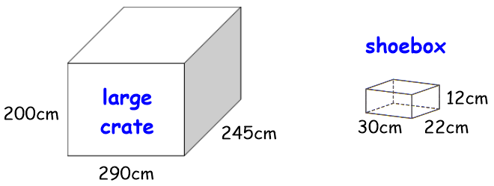
National 5 Applications of Maths
Box Packing
Example 1
Shoe boxes measuring 30cm by 22cm by 12cm are being packed into a large
crate measuring 200cm by 245cm by 290cm.

Slide 5
National 5 Applications of Maths
Box Packing

Slide 6
National 5 Applications of Maths
Box Packing
Example 2: What is the maximum number of boxes of 1m x 1m x 1.5, that you can fit in a larger container on 2m x 3m x 4m?
3m
1m
1m
2m
1.5m
4m

Slide 7
National 5 Applications of Maths
Box Packing
Exam Style
Example 3: What is the maximum number of boxes you can fit in the large container. a) The boxes must be stacked as shown in the arrow.
12cm
3.5m
20cm
30cm
2.7m
4.8m

Slide 8
National 5 Applications of Maths
Box Packing
Exam Style
Example 3: What is the maximum number of boxes you can fit in the large container. b) It costs £1.40 to pack each box and £600 for the container. What is the total cost of packing away the containers?
12cm
3.5m
20cm
30cm
2.7m
4.8m

