Slide 1
National 5 Applications of Maths
Negative Numbers and Scales
Negative Numbers and Temperature
Reading Scales
Reading Scale Past Paper Style (Includes fractions and percentages)

Slide 2
National 5 Applications of Maths
Negative Numbers and Scales
Negative Numbers and Temperature
Basic Skills – Try these yourself
7 – 11
- 3 + 7
- 8 – 15
-5 + (-4)
-8 – (-6)
5 – ( - 3)
10 – 20
-14 - 29
45 – 93
-13 – 85
65 – 92
45 – (-22)

Slide 3
National 5 Applications of Maths
Negative Numbers and Scales
Negative Numbers and Scales
Basic Skills – Try these yourself
7 – 11 = -4
- 3 + 7 = 4
- 8 – 15 = -23
-5 + (-4) = -9
-8 – (-6) = -2
5 – ( - 3) = 8
10 – 20 = -10
-14 – 29 = -41
45 – 93 = -48
-13 – 85 = -98
65 – 92 = -27
45 – (-22) = 67

Slide 4
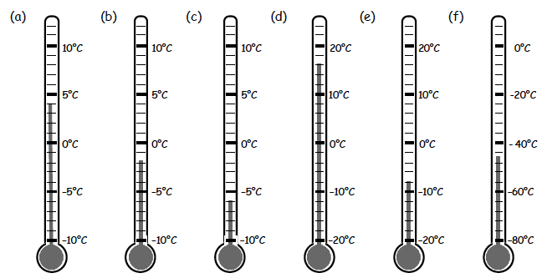
National 5 Applications of Maths
Negative Numbers and Scales
National 5 Applications of Maths
Read the temperatures on the following thermometers
Teejay N5 Chapter 1 Ex 2 page 13

Slide 5
National 5 Applications of Maths
Negative Numbers and Scales
Reading Scales

Slide 6
National 5 Applications of Maths
Negative Numbers and Scales
National 5 Applications of Maths
Negative Numbers and Scales
Worksheet – N5 Apps Reading Scales

Slide 7
National 5 Applications of Maths
Negative Numbers and Scales
Reading Scale Exam Style
Example 1: Peter is driving in a car and looks at the fuel gauge. His car also tells him that he can drive 250 miles. How far can the car travel when the tank is full?

Slide 8
National 5 Applications of Maths
Negative Numbers and Scales
Reading Scale Exam Style
Example 2: Gail is baking a cake. She is adding sugar to her mixture but realises she needs to add an extra 15%. What is the weight of the sugar Gail should have on her scale?

Slide 9
National 5 Applications of Maths
Negative Numbers and Scales
Reading Scale Exam Style
Example 3: Will is driving a truck. When his tank is full it holds 80L of fuel.
Mark on the diagram 25L

