Slide 1
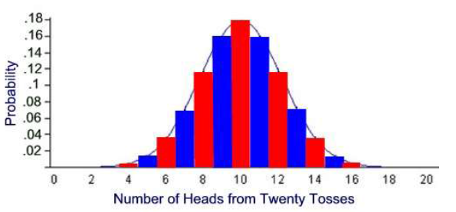
Higher Applications of Mathematics
Higher Applications: Statistics Unit
Normal Distribution
The Normal Distribution is a very frequently occurring continuous variable distribution.
In models, for example, the heights of people, the weights of similar animals, and measurements on machine produced items are all normally distributed.
For example, if a coin is thrown 20 times the most likely number of Heads is 10, followed by 9or 11 Heads, then 8 or 12 Heads and so on. Getting something like 5 or 15 Heads is relatively unlikely. The full bar chart for throwing a coin 20 times is shown below, and is overlaid with the normal curve.

Slide 2
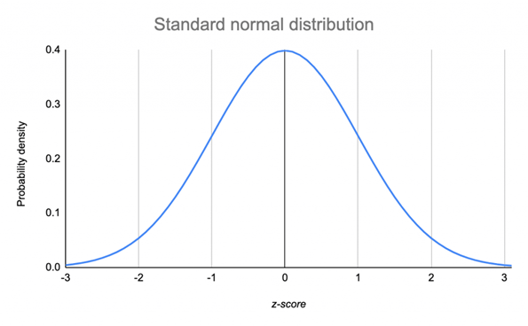
Higher Applications of Mathematics
Higher Applications: Statistics Unit
The distribution is symmetrical about the mean, which is also the median and the mode.
The curve is symmetrical about the mean
50% of values are below the mean
50% of values are above the mean
68% of values fall within 1 standard deviation
95% of values fall within 2 standard deviations
99.5% of values fall within 3 standard deviations

Slide 3
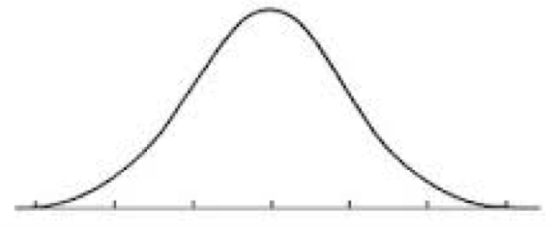
Higher Applications of Mathematics
Higher Applications: Statistics Unit
Example: The height of women in the UK follows a normal distribution. The mean is 161cm and the standard deviation is 6cm.
Complete the graph below showing the heights for 68%, 95% and 99.5% of the data.

Slide 4
Higher Applications of Mathematics
Higher Applications: Statistics Unit
Example: The life of a food mixer is normally distributed with mean 90 months and standard deviation of 15 months.
(a) What proportion of mixers last less than 90 months
(b) What proportion of mixers last between 75 and 105 months
(c) What proportion of mixers last less than 60 months?

Slide 5
Higher Applications of Mathematics
Higher Applications: Statistics Unit
Exercise: Normal Distribution
Sketch a normal curve for each distribution. Label the x-axis at one, two, and three standard deviations from the mean.
1. Mean = 95; standard deviation = 12
2. Mean = 100; standard deviation = 15
3. Mean = 60; standard deviation = 6
4. Mean = 23.8; standard deviation = 5.2
5. A set of data has a normal distribution with a mean of 5.1 and a standard deviation of 0.9.
(a) Sketch a normal curve for the distribution.
Find the percent of data within each interval.
(b) Between 6.0 and 6.9
(c) Greater than 6.9
(d) Between 4.2 and 6.0
(e) Less than 4.2
6. Test scores are normally distributed with a mean of 76 and a standard deviation of 10.
a. In a group of 230 tests, how many students score above 96?
b. In a group of 230 tests, how many students score below 66?
c. In a group of 230 tests, how many students score within one standard deviation of the mean?

Slide 6
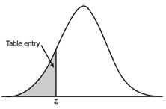
Higher Applications of Mathematics
Higher Applications: Statistics Unit
Normal Distribution Z-Table
Normal Distribution tables use the standard normal distribution with a mean of 0 and a standard deviation of 1.
The table shows the values of z which measures the distance from the mean in standard deviations.
The shaded area, A, gives the probability of data that is less than the given value z.

Slide 7
Higher Applications of Mathematics
Higher Applications: Statistics Unit
For the following you will need the use of a z-table
Example: Calculate P(Z<0.24)
This is the percentage of data that is below 0.24 standard deviations away from the mean.
Example: Calculate P(Z<-1.3)
Example: Calculate P(Z>0.75)

Slide 8
Higher Applications of Mathematics
Higher Applications: Statistics Unit
Example: Calculate P(Z > -2.34)

Slide 9
Higher Applications of Mathematics
Higher Applications: Statistics Unit
Z Table Exam Questions.
The formula to calculate the Z number is as follows
$$Z=\frac{X− μ}{sd}$$
Example: Most graduate schools of business require applicants for admission to take the Graduate Management Admission Council’s GMAT examination. Scores on the GMAT are roughly normally distributed with a mean of 527 and a standard deviation of 112. What is the probability of an individual scoring above 500 on the GMAT?

Slide 10
Higher Applications of Mathematics
Higher Applications: Statistics Unit
(b) How high must an individual score on the GMAT in order to score in the highest 5%?

Slide 11
Higher Applications of Mathematics
Higher Applications: Statistics Unit
Example: The average number of acres burned by forest and range fires in a large New Mexico county is 4,300 acres per year, with a standard deviation of 750 acres. The distribution of the number of acres burned is normal. What is the probability that between 2,500 and 4,200 acres will be burned in any given year?

