Slide 1
National 5 Applications of Maths
Charts, Graphs and Tables
Reading Bar Charts and Line Graphs
Stem and Leaf Diagrams
Reading Pie Charts
Drawing Pie Charts
Scatter Graphs
Exam Questions

Slide 2
National 5 Applications of Maths
Charts, Graphs and Tables
Reading Tables
Example 1: From the following table get the following information
How many pupils said History was their favourite subject
How many pupils were asked in total
What percentage of pupils said PE (to 2 significant figures)

Slide 3
National 5 Applications of Maths
Charts, Graphs and Tables
Reading Tables
Example 2: The following is a line graph about the average temperature taken of a swimming pool throughout each day. Answer the following question based on the line graph.
What day do you think the swimming pool was closed and why?
What was the difference between the highest and lowest temperature?

Slide 4
National 5 Applications of Maths
Charts, Graphs and Tables
Stem and Leaf Diagrams
Constructing
Example 1: Construct a stem and leaf chart for the data below, which shows the times in minutes in which 20 college students ran a 10 km race.
64 45 48 70 49 51 38 46 57
56 47 63 52 46 60 66 59 72

Slide 5
National 5 Applications of Maths
Charts, Graphs and Tables
Example 2: Construct a stem and leaf chart for this data which shows the engine sizes in litres of the 24 cars, vans and lorries in a service station.
1.8 2.4 3.2 1.1 1.6 1.6 1.0 2.4 3.0 1.4
2.8 3.2 5.0 4.8 1.8 4.5 2.4 1.2 5.6 1.8
2.0 4.5 1.2 1.1

Slide 6
National 5 Applications of Maths
Charts, Graphs and Tables
Reading Stem and Leaf diagrams
Ordered
n = 24
1
0
1
1
2
2
4
6
6
8
8
8
2
0
4
4
4
8
3
0
2
2
4
5
5
8
Key:
1/8 means 1.8 litres
5
0
6
What was the smallest engine size?
How big a range was there in engine sizes?
What is the median engine size?

Slide 7
National 5 Applications of Maths
Charts, Graphs and Tables
Back to back Stem and Leaf Diagrams
When we have data we want to compare, it is useful to draw a Back-to-Back Stem and Leaf Chart.
Example 3: Compare the growth of these plants where group A has been given feed and group B has not. Heights are given in cm.
With Feed – Group A
9.1 14.2 10.5 13.4 12.6
10.4 11.3 10.6 9.2 11.4
13.7 12.0 12.5 9.2 13.0
11.8 14.3 11.8 12.0 12.6
Without Feed – Group B
9.1 10.0 12.0 11.9 13.7
14.3 9.5 11.7 9.3 10.4
12.3 9.5 11.4 12.3 9.7
13.7 13.2 10.6 10.6 11.2
Draw a back-to-back stem and leaf chart.

Slide 8
National 5 Applications of Maths
Charts, Graphs and Tables
Back to Back Stem and Leaf Diagrams
With Feed – Group A
9.1 14.2 10.5 13.4 12.6
10.4 11.3 10.6 9.2 11.4
13.7 12.0 12.5 9.2 13.0
11.8 14.3 11.8 12.0 12.6
Without Feed – Group B
9.1 10.0 12.0 11.9 13.7
14.3 9.5 11.7 9.3 10.4
12.3 9.5 11.4 12.3 9.7
13.7 13.2 10.6 10.6 11.2

Slide 9
National 5 Applications of Maths
Charts, Graphs and Tables
Reading Pie Charts
Example 1: A Pie Chart was recorded after 240 people voted on their favourite superhero.
State how many people voted for each Superhero.

Slide 10
National 5 Applications of Maths
Charts, Graphs and Tables
Drawing Pie Charts
Example 1: The table below shows a group of students favourite sport, construct a pie chart to show his information.
Sport | Frequency | Angle
Football | 40
Rugby | 30
Basketball | 10
Tennis | 10
Total

Slide 11
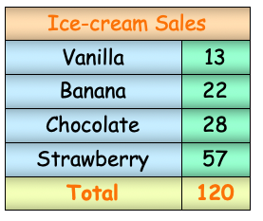
National 5 Applications of Maths
Charts, Graphs and Tables
Example 2: A survey was taken of peoples favourite ice cream, construct a pie chart to shown this information.

Slide 12
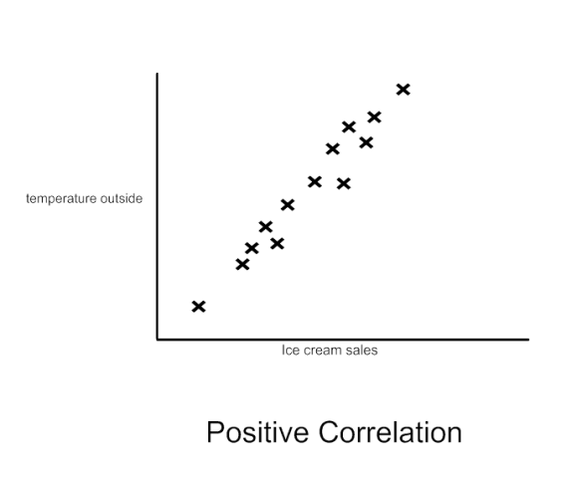
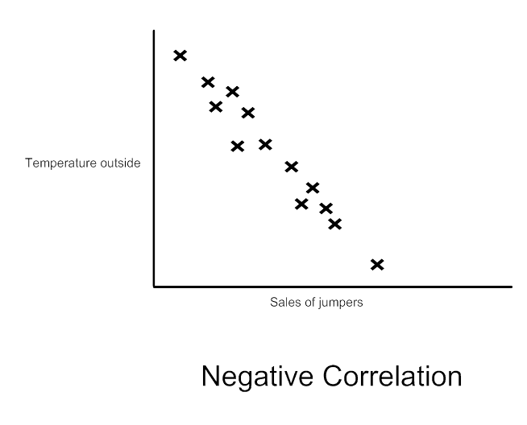
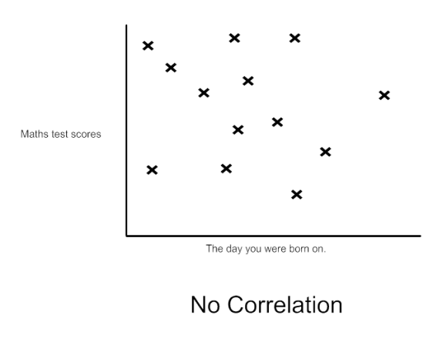
National 5 Applications of Maths
Charts, Graphs and Tables
Scattergraphs and Lines of Best Fit
Types of Correlation

Slide 13
National 5 Applications of Maths
Charts, Graphs and Tables
Example 1
Student | Test A | Test B
Tom | 50 | 60
Mary | 40 | 40
Sarah | 35 | 25
David | 90 | 80
Kyle | 68 | 60
Alan | 60 | 50

Slide 14
National 5 Applications of Maths
Charts, Graphs and Tables
A line of best fit must
Have the correct correlations
Go through as many points as possible while keeping the same amount on either side
Note: It does not have to go through the origin.
Q1. Alan got 80 in test A, estimate his score in test B.
Q2. Julie got 50% in test A and therefore says she would have got 50% in test B is she correct to assume this?

Slide 15
National 5 Applications of Maths
Charts, Graphs and Tables
Example 2
A survey was conducted into a pupil’s hand span and their shoe size. The results are shown below:
a) Describe the correlation shown.
b) What size feet would you expect from a pupil with a handspan of 14 cm?
c) What size of handspan would you expect from a pupil with size 7 feet?
Handspan (cm) | 15 | 16 | 18 | 17 | 15.5 | 13.5 | 20 | 22 | 18
Shoe Size | 3 | 4 | 5 ½ | 5 | 4 ½ | 3 | 6 | 8 | 6

Slide 16
National 5 Applications of Maths
Charts, Graphs and Tables
Exam Questions
Example 1. A survey was done on the different members of staff working in a supermarket throughout a week. Given that there were 60 employees asked.
Find the number of employees that work in management?
What is the probability that an employee selected at random works in grocery?
48º
96º
168º
42º

Slide 17
National 5 Applications of Maths
Charts, Graphs and Tables
Exam Questions
Example 2. Turn the following Bar Chart about cars that are getting on to a Ferry into a Pie Chart.

Slide 18
National 5 Applications of Maths
Charts, Graphs and Tables
Exam Questions
Example 3. A stem and leaf diagram is drawn to show battery life 19 phone for two different brands.
a) State the most common battery life from Brand A.
b) What is the difference in the median of both the brands?
n = 19
n = 19

