Slide 1
Higher Applications of Mathematics
Higher Applications: Statistics Unit

Slide 2
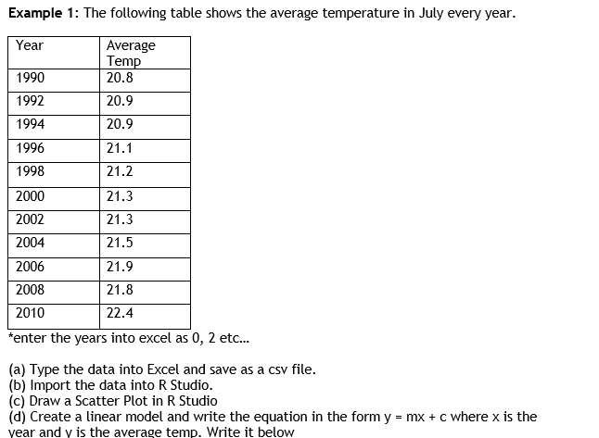
Higher Applications of Mathematics
Higher Applications: Statistics Unit

Slide 3
Higher Applications of Mathematics
Higher Applications: Statistics Unit

Slide 4
Higher Applications of Mathematics
Higher Applications: Statistics Unit

Slide 5
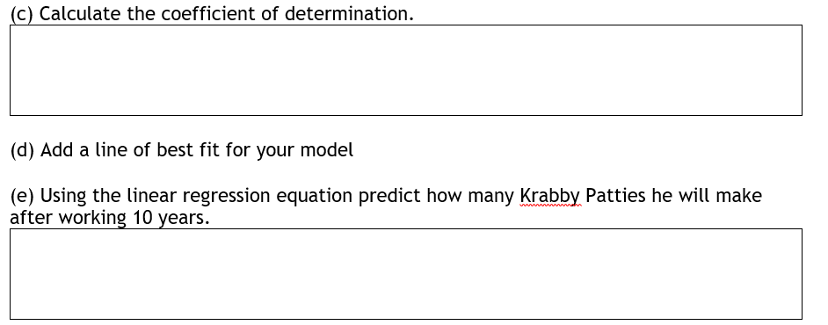
Higher Applications of Mathematics
Higher Applications: Statistics Unit

Slide 6
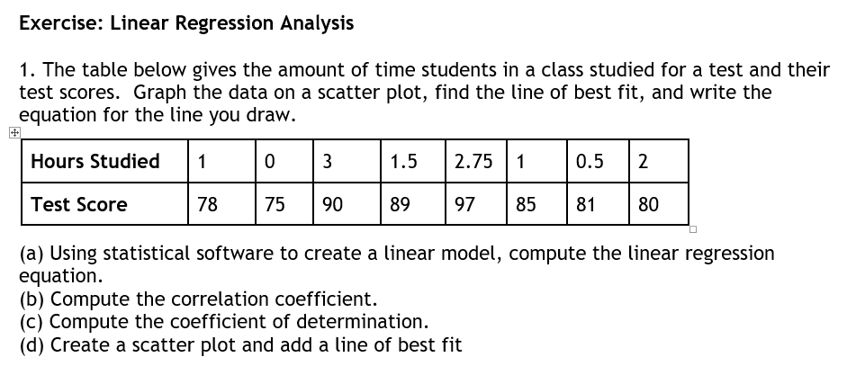
Higher Applications of Mathematics
Higher Applications: Statistics Unit

Slide 7
Higher Applications of Mathematics
Higher Applications: Statistics Unit

