Slide 1
National 5 Applications of Maths
Fractions
Converting between Top Heavy and Mixed Numbers
Adding and Subtracting Fractions
Multiplying and Dividing Fractions
Exam Style Questions

Slide 2
National 5 Applications of Maths
Fractions
Converting between Top Heavy and Mixed Numbers
Mixed Numbers to Top Heavy
Ex 1. $5\frac{1}{3}$
Ex 2. $3\frac{4}{7}$
Ex 3. $10\frac{7}{13}$

Slide 3
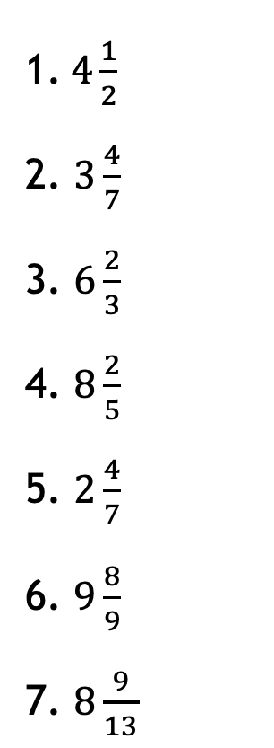
National 5 Applications of Maths
Fractions
Converting between Top Heavy and Mixed Numbers
1. $4\frac{1}{2}$
2. $3\frac{4}{7}$
3. $6\frac{2}{3}$
4. $8\frac{2}{5}$
5. $2\frac{4}{7}$
6. $9\frac{8}{9}$
7. $8\frac{9}{13}$
8. $20\frac{11}{20}$
9. $42\frac{7}{8}$
10. $65\frac{13}{15}$

Slide 4
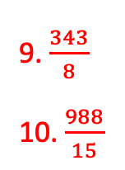
National 5 Applications of Maths
Fractions
Converting between Top Heavy and Mixed Numbers
1. $4\frac{1}{2}$
2. $3\frac{4}{7}$
3. $6\frac{2}{3}$
4. $8\frac{2}{5}$
5. $2\frac{4}{7}$
6. $9\frac{8}{9}$
7. $8\frac{9}{13}$
8. $20\frac{11}{20}$
9. $42\frac{7}{8}$
10. $65\frac{13}{15}$
Answers
1. $\frac{9}{2}$
2. $\frac{25}{7}$
3. $\frac{20}{3}$
4. $\frac{42}{5}$
5. $\frac{18}{7}$
6. $\frac{89}{9}$
7. $\frac{ 111}{13}$
8. $\frac{411}{20}$
9. $\frac{343}{8}$
10. $\frac{988}{15}$

Slide 5
National 5 Applications of Maths
Fractions
Converting between Top Heavy and Mixed Numbers
Top Heavy to Mixed Numbers
Ex 1. $\frac{18}{5}$
Ex 2. $\frac{45}{11}$
Ex 3. $\frac{158}{3}$

Slide 6
National 5 Applications of Maths
Fractions
Adding and Subtracting Fractions
Ex 1. $\frac{4}{5}+\frac{2}{5}$
Ex 2. $\frac{9}{11} −\frac{4}{11}$

Slide 7
National 5 Applications of Maths
Fractions
Adding and Subtracting Fractions
Ex 3. $\frac{1}{3}+\frac{1}{6}$
Ex 4. $\frac{2}{3} −\frac{4}{9}$

Slide 8
National 5 Applications of Maths
Fractions
Adding and Subtracting Fractions
Ex 5. $\frac{4}{5}+\frac{4}{7}$
Ex 6. $\frac{6}{7} −\frac{1}{3}$

Slide 9
National 5 Applications of Maths
Fractions
Adding and Subtracting Fractions
Ex 7. $1\frac{1}{5}+3\frac{5}{9}$
N5 Apps Fractions Worksheet Section 1

Slide 10
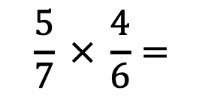
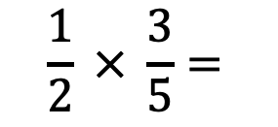
National 5 Applications of Maths
Fractions
Multiplying and Dividing Fractions
Easier than adding and subtracting!
You just multiply along the top and along the bottom (like train tracks), then you need to simplify.
$$\frac{1}{2} × \frac{3}{5}=$$
$$\frac{5}{7} × \frac{4}{6}=$$

Slide 11
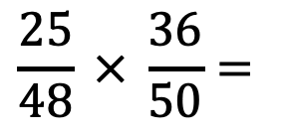
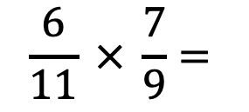
National 5 Applications of Maths
Fractions
Multiplying and Dividing Fractions
Easier than adding and subtracting!
You just multiply along the top and along the bottom (like train tracks), then you need to simplify.
$$\frac{6}{11} × \frac{7}{9}=$$
$$\frac{25}{48} × \frac{36}{50}=$$

Slide 12
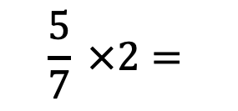
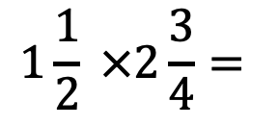
National 5 Applications of Maths
Fractions
Multiplying and Dividing Fractions
$$1\frac{1}{2} ×2\frac{3}{4}=$$
$$\frac{5}{7} ×2=$$

Slide 13

National 5 Applications of Maths
Fractions
Multiplication
1.
a) $\frac{1}{3}$ x $\frac{4}{5}$
b) $\frac{3}{5}$ x $\frac{1}{7}$
c) $\frac{1}{6}$ x $\frac{1}{4}$
d) $\frac{4}{5}$ x $\frac{1}{16}$
e) $\frac{21}{32}$ x $\frac{4}{7}$
f) $\frac{1}{9}$ x $\frac{12}{13}$
g) $\frac{5}{16}$ x $\frac{6}{25}$
2.
a) $1\frac{1}{4}$ x $1\frac{1}{2}$
b) 3$\frac{1}{4}$ x $1\frac{1}{3}$
c) $2\frac{1}{2}$ x $5$
d) $7\frac{1}{2}$ x $2\frac{2}{3}$
e) $1\frac{1}{15}$ x 2$\frac{1}{2}$
f) $2\frac{1}{7}$ x 3$\frac{3}{4}$
g) $2\frac{5}{8}$ x 3$\frac{2}{7}$

Slide 14
National 5 Applications of Maths
Fractions
Multiplication
1.
a) $\frac{1}{3}$ x $\frac{4}{5}$
b) $\frac{3}{5}$ x $\frac{1}{7}$
c) $\frac{1}{6}$ x $\frac{1}{4}$
d) $\frac{4}{5}$ x $\frac{1}{16}$
e) $\frac{21}{32}$ x $\frac{4}{7}$
f) $\frac{1}{9}$ x $\frac{12}{13}$
g) $\frac{5}{16}$ x $\frac{6}{25}$
2.
a) $1\frac{1}{4}$ x $1\frac{1}{2}$
b) 3$\frac{1}{4}$ x $1\frac{1}{3}$
c) $2\frac{1}{2}$ x $5$
d) $7\frac{1}{2}$ x $2\frac{2}{3}$
e) $1\frac{1}{15}$ x 2$\frac{1}{2}$
f) $2\frac{1}{7}$ x 3$\frac{3}{4}$
g) $2\frac{5}{8}$ x 3$\frac{2}{7}$
Answers
4/15
3/35
1/24
1/20
3/8
4/39
3/40
Answers
15/8
13/3
25/2
20
16/9
225/28
69/8

Slide 15
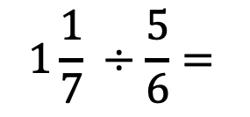
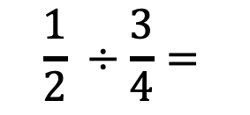
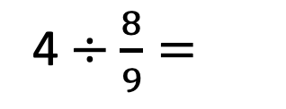
National 5 Applications of Maths
Fractions
Dividing Fractions
$$\frac{1}{2} ÷\frac{3}{4}=$$
$$1\frac{1}{7} ÷\frac{5}{6}=$$
4$÷\frac{8}{9}=$
N5 Apps Fractions Worksheets Section 2

Slide 16
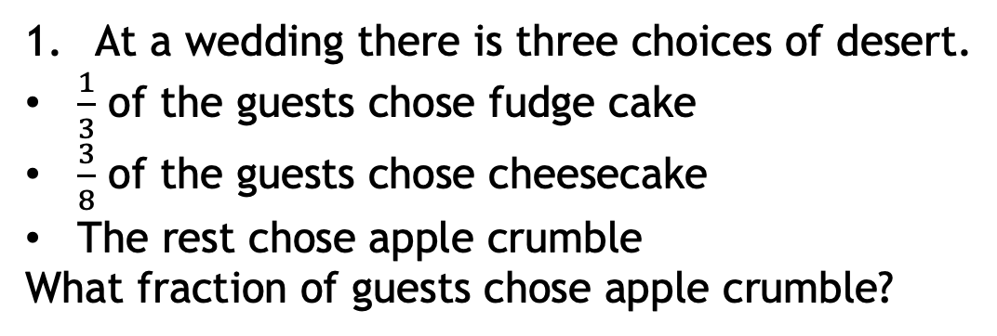
National 5 Applications of Maths
Fractions
Exam Questions
At a wedding there is three choices of desert.
$\frac{1}{3}$ of the guests chose fudge cake
$\frac{3}{8}$ of the guests chose cheesecake
The rest chose apple crumble
What fraction of guests chose apple crumble?

Slide 17
National 5 Applications of Maths
Fractions
Exam Questions
2. At a paper company there are different departments including sales, accounting and HR.
$\frac{3}{11}$ of the employees work in HR
Half the number of people in HR work in accounting
2 $\frac{1}{2}$ times the number of people in accounting work in sales.
What fraction of the company work in sales?

