Slide 1
Higher Applications of Mathematics
Higher Applications: Statistics Unit
Graphical Representations.
You will have seen different graphs and charts before. You should be familiar with the creating and interpreting the following.
Bar Chart
Line Graph
Pie Chart
Stem and Leaf Diagram
Scatter graph and line of best fit
Boxplot
In the following series of lessons you will also be introduced to new graphs such as Histograms, along with new concepts such as Correlation and Normality.

Slide 2
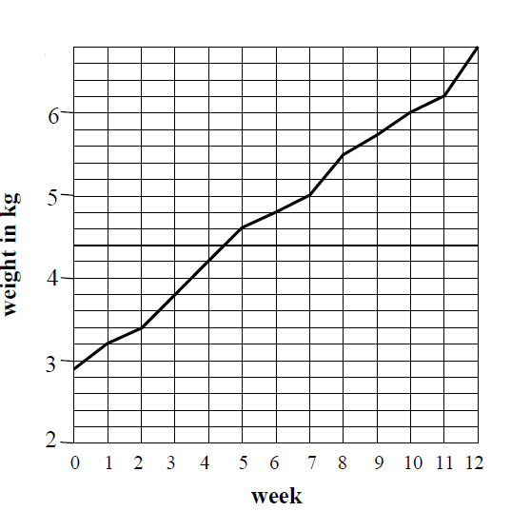
Higher Applications of Mathematics
Higher Applications: Statistics Unit
Example 1: The following graph shows a baby’s weight throughout the year.
(a) What was the baby’s weight at birth?
(b) What did the baby weigh after 5,9 and 12 weeks?
(c) How much weight did the baby put on between 3 and 7 weeks?
(d) Between which two consecutive weeks was the greatest increase in weight?

Slide 3
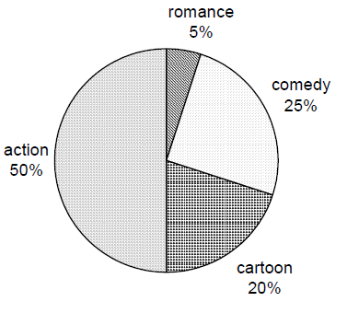
Higher Applications of Mathematics
Higher Applications: Statistics Unit
Example 2: The following pie chart was made to show pupil’s favourite genre of film.
(a)What fraction of pupils chose each type of film?
(b) If 90 pupils said cartoons, how many pupils were asked in total?

Slide 4
Higher Applications of Mathematics
Higher Applications: Statistics Unit
Example 3: A poll is taken of different votes in an area.
Blue | Red | Green | Yellow | Orange | Purple
3200 | 5000 | 2000 | 5800 | 1800 | 300
Input the table into Excel and decide what kind of charts are suitable and which are not.
State which kind of table you found suitable.

Slide 5
Higher Applications of Mathematics
Higher Applications: Statistics Unit
Example 4. The following shows the average attendance of a cinema in Glasgow throughout the first 12 weeks of the year which the number indicating the percentage of tickets sold in the median showing.
(a) Using Excel decide what type of graph is suitable, state which graph you have chosen and why?
1 | 2 | 3 | 4 | 5 | 6 | 7 | 8 | 9 | 10 | 11 | 12
56 | 54 | 40 | 79 | 73 | 63 | 55 | 88 | 62 | 60 | 51 | 83
(b) What does the information tell you about the attendance of cinema’s why do you think that is?
(c) What kind of graph would be suitable to show the spread of the information?

Slide 6
Higher Applications of Mathematics
Higher Applications: Statistics Unit

