Slide 1
Higher Applications of Mathematics
Higher Applications: Statistics Unit

Slide 2
Higher Applications of Mathematics
Higher Applications: Statistics Unit

Slide 3
Higher Applications of Mathematics
Higher Applications: Statistics Unit

Slide 4
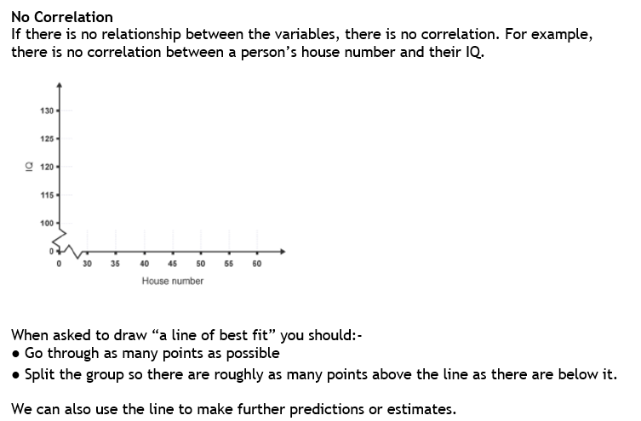
Higher Applications of Mathematics
Higher Applications: Statistics Unit

Slide 5
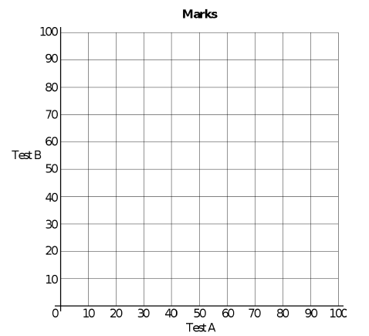
Higher Applications of Mathematics
Higher Applications: Statistics Unit

Slide 6
Higher Applications of Mathematics
Higher Applications: Statistics Unit

Slide 7
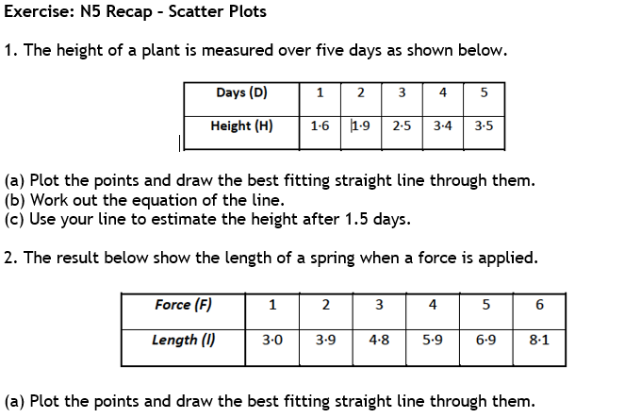
Higher Applications of Mathematics
Higher Applications: Statistics Unit

Slide 8
Higher Applications of Mathematics
Higher Applications: Statistics Unit

Slide 9
Higher Applications of Mathematics
Higher Applications: Statistics Unit

Slide 10
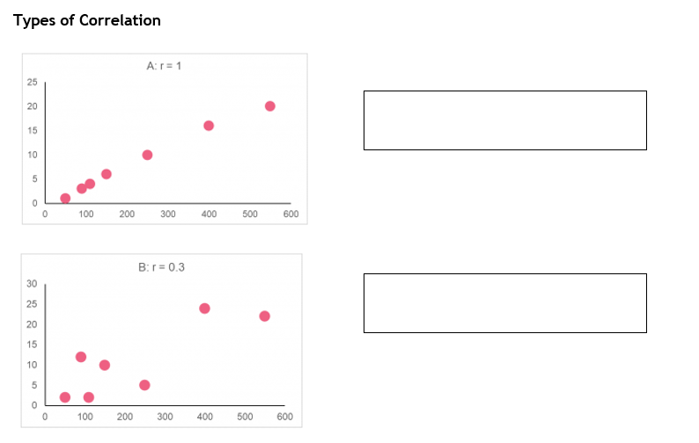
Higher Applications of Mathematics
Higher Applications: Statistics Unit

Slide 11
Higher Applications of Mathematics
Higher Applications: Statistics Unit

Slide 12
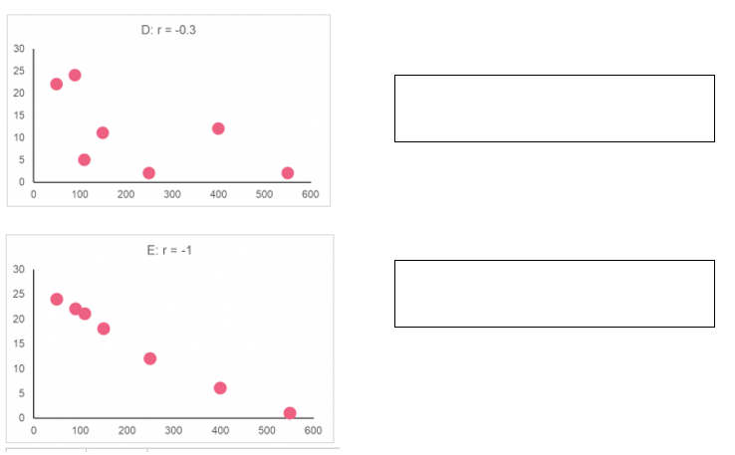
Higher Applications of Mathematics
Higher Applications: Statistics Unit

Slide 13
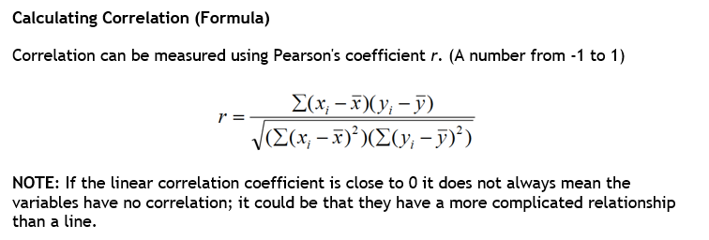
Higher Applications of Mathematics
Higher Applications: Statistics Unit

Slide 14
Higher Applications of Mathematics
Higher Applications: Statistics Unit

