Slide 1
National 5 Applications of Maths
Scale Drawing and Bearings
Scale Drawing
Bearings
Scale Drawing and Bearings Exam Questions

Slide 2
National 5 Applications of Maths
Scale Drawing and Bearings
Example 1:
Make a Scale Drawing of the following diagram using 1cm to represent 3m.
Measure the height of the tree in cm
What is the real-life height of the tree

Slide 3
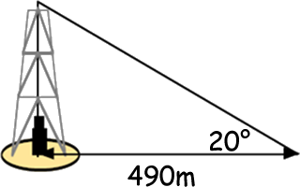
National 5 Applications of Maths
Scale Drawing and Bearings
Example 2: The diagram is a sketch of an oil rig in a desert.
Using a suitable scale, make a scale drawing of the triangle in the diagram and use it to find the real-life height of the rig.
TeeJay N5 Lifeskills page 127

Slide 4
National 5 Applications of Maths
Scale Drawing and Bearings
Bearings and Scale Drawing.
Bearings are angles that have two properties
1. They are measured clockwise from north
2. They must have three figures
Drawing Bearings
Example: Draw the bearing 045
N
045

Slide 5
National 5 Applications of Maths
Scale Drawing and Bearings
Example 2: Draw the bearing, 85º for 5cm
N
1. Be measured from the NORTH
2. Be measured in a CLOCKWISE direction
085 º
3. Have 3 figures
5cm

Slide 6
National 5 Applications of Maths
Scale Drawing and Bearings
Example 3: Draw the bearing, 220º for 3cm
N
1. Be measured from the NORTH
2. Be measured in a CLOCKWISE direction
220 º
3. Have 3 figures
3cm

Slide 7
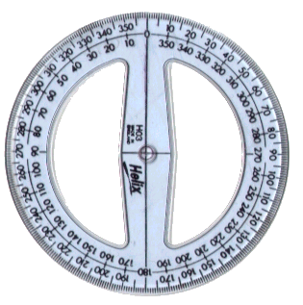
National 5 Applications of Maths
Scale Drawing and Bearings
(1a) Measure the bearing of B from A
(1b) Measure the bearing of A from B
(b) Measure the bearing of A from B
(2a) Measure the bearing of D from C
(2b) Measure the bearing of C from D
(b) Measure the bearing of A from B
045°
145°
Reading
Bearings
225°
325°
° C
° B
° A
° D

Slide 8
National 5 Applications of Maths
Scale Drawing and Bearings
Exam Questions
Example 1: Example 1: A ship leaves a harbour at H. It travels for a distance of 50km on a bearing of 070 where it arrives at Port A.
It then leaves Port A to travel to Port B, on bearing of 145 for 30km. Using a scale of 1cm = 5km draw a scale drawing of this and then calculate how far away is port B from the harbour?
Lets break down the question into smaller parts
1. Draw the first journey
2. Draw the second journey
3. Draw a line between Harbour and Port B to create a triangle
4. Measure the length of this line in cm
5. Convert to km

Slide 9
National 5 Applications of Maths
Scale Drawing and Bearings
Example 2. Take 1cm = 10km. The bearings and distances of two tankers from Aberdeen are Tanker1 [044º,79km] and Tanker2 [175º,89km]. How far apart are the tankers?

Slide 10
National 5 Applications of Maths
Scale Drawing and Bearings
Example 3. An airplane leaves Leuchers airport and flies 80 miles north. It then changes direction and flies 120 miles east. The plane now turns onto a bearing of 126° and flies a further 164 miles. Calculate the bearing and distance of the plane from Leuchers.

Slide 11
National 5 Applications of Maths
Scale Drawing and Bearings

