Slide 1
National 5 Applications of Maths
Non Calculator Work
Standard Deviation
Exam Questions

Slide 2
National 5 Applications of Maths
Standard Deviation
Standard Deviation is commonly known as the measure of the “spread of data”.
The standard deviation is the measure of on average how close the data is to the mean.

Slide 3
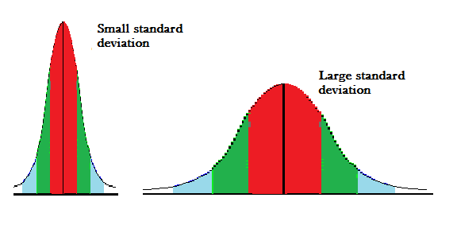
National 5 Applications of Maths
Standard Deviation
So if the Standard Deviation is small then values in the data are close to the mean
If the standard deviation is big then the data is more spread out.

Slide 4
National 5 Applications of Maths
Standard Deviation
If the Standard Deviation is high
Greater spread of results
Results vary more (more varied)
Less consistent
If the Standard Deviation is low
Results are less spread out
Vary less (less varied)
More consistent

Slide 5
National 5 Applications of Maths
Standard Deviation
Standard Deviation
1,1,1,1,1,1,1,1,1,1,1
Approx 11
1, 105, 400, 1000, 21000
Approx 2.3
5, 10, 15, 20, 25
Approx 7
90, 91, 92, 92, 93, 93
Approx. 8000
80,81, 82, 90, 100, 110, 130
0

Slide 6
National 5 Applications of Maths
Standard Deviation

Slide 7
National 5 Applications of Maths
Standard Deviation
Example 1
Find the standard deviation of the
following data: 1, 3, 3, 4, 5, 5, 6, 7, 7, 7

Slide 8
National 5 Applications of Maths
Standard Deviation
Example 2
Find the standard deviation of the
following data: 2, 5, 11, 14, 14, 22, 37

Slide 9
National 5 Applications of Maths
Standard Deviation
Exam Questions
Example 1: The price of milk in shops are as follows
49 44 41 52 47 43
a) Find mean and standard deviation of the prices of milk

Slide 10
National 5 Applications of Maths
Standard Deviation
Example 1: The price of milk in shops are as follows
49 44 41 52 47 43
b) The prices of sugar in shops have an average prove of 52p and a standard deviation of 3.9. Make two valid comparisons between the prices of milk and sugar.

Slide 11
National 5 Applications of Maths
Standard Deviation
Example 2: The prices (in pounds) of 6 two-bedroom flats in Glasgow are as follows
85000 98000 140000 110000 120000
a) Calculate the mean and standard deviation of the prices of the flats.

Slide 12
National 5 Applications of Maths
Standard Deviation
Example 2: The prices (in pounds) of 6 two-bedroom flats in Glasgow are as follows
85000 98000 140000 110000 120000
b) The mean price for a two bedroom flat in Edinburgh is £128000 and the standard deviation is £2600. Make two valid comparisons about the prices of flats in Glasgow and Edinburgh.

