Slide 1
National 5 Applications of Maths
Perimeter, Area and Volume
Perimeter
Simple and Composite Area
Circumference and Area of Circles
Perimeter and Area Exam Questions
Volume of a Cuboid
Volume of a Prism
Volume of a Cylinder
Volume of a Cone
Volume of a Sphere and Hemisphere
Volume Exam Style Questions.
Surface Area of a Cuboid

Slide 2
National 5 Applications of Maths
Perimeter, Area and Volume
Perimeter – Length around a shape.
Example 1. Calculate the perimeter of the shape.
3.7cm
9.2cm

Slide 3
National 5 Applications of Maths
Perimeter, Area and Volume
Example 2. Calculate the perimeter of the shape.
3.1cm
3.1cm
4.5cm
4.5cm
5.2cm

Slide 4
National 5 Applications of Maths
Perimeter, Area and Volume
Example 3. The Grants are building buying a new fence for their garden, the dimensions of which are below.
Calculate the perimeter of the garden.
If it costs £7.49 for every meter of fence, calculate the cost of the fence.
3m
6m
11m

Slide 5
National 5 Applications of Maths
Perimeter, Area and Volume
Area and Composite Areas
Example 1. Calculate the area of the shape.
4cm
12.4cm

Slide 6
National 5 Applications of Maths
Perimeter, Area and Volume
Example 2. Calculate the area of the shape.
5cm
8.4cm

Slide 7
National 5 Applications of Maths
Perimeter, Area and Volume
Example 3. Calculate the area of the shape.
2.4m
5.5m
8.6m
5m

Slide 8
National 5 Applications of Maths
Perimeter, Area and Volume
Example 4. A room in a house has the following layout. It costs £3.50 for every m² for flooring, calculate the cost to put a new floor for the room.
6m
4m
9m

Slide 9
National 5 Applications of Maths
Perimeter, Area and Volume
Circles – Circumference and Area
$$C= π × d$$
Example 1: Find the circumference of a circle that has diameter 6cm.
6cm

Slide 10
National 5 Applications of Maths
Perimeter, Area and Volume
Example 2: Find the circumference of a circle.
10.5cm

Slide 11
National 5 Applications of Maths
Perimeter, Area and Volume
Example 3: Find the perimeter of this shape.
14cm

Slide 12
National 5 Applications of Maths
Perimeter, Area and Volume
$$A= π × r^{2}$$
Example 3: Find the area of the circle.
8cm

Slide 13
National 5 Applications of Maths
Perimeter, Area and Volume
Example 4: Find the area of the semicircle below.
10.4cm

Slide 14
National 5 Applications of Maths
Perimeter, Area and Volume
Example 5: Find the area of the shape below.
5cm
12cm

Slide 15
National 5 Applications of Maths
Perimeter, Area and Volume
Perimeter and Area – Exam Questions
Example 1: A new window of a church is shaped in a rectangle with a semi circle at the top as shown in the image below.
A metal frame is to go round the edge of the shape.
a) Calculate the length of the metal bar required.
1.3m
80cm

Slide 16
National 5 Applications of Maths
Perimeter, Area and Volume
Perimeter and Area – Exam Questions
Example 1: A new window of a church is shaped in a rectangle with a semi circle at the top as shown in the image below.
It costs £3.99 for every 40cm of metal for the bars.
b) How much will it cost to make the entire bar.
1.3m
80cm

Slide 17
National 5 Applications of Maths
Perimeter, Area and Volume
Perimeter and Area – Exam Questions
Example 2: The Smiths are building a new Kitchen, the floor plans are shown below.
6.5m
Packs of floor tiles are sold as £9.50 for every 2m².
a) Calculate the cost to tile the entire floor.
3.5m
8m

Slide 18
National 5 Applications of Maths
Perimeter, Area and Volume
Perimeter and Area – Exam Questions
Example 2: The Smiths are building a new Kitchen, the floor plans are shown below.
6.5m
A building company offers to do the job including the price of materials for £200. The Smiths pay this using the following plan.
10% as a desposit
10 instalments of 12.90
One final payment.
b) How much will the final payment be?
3.5m
8m

Slide 19
National 5 Applications of Maths
Perimeter, Area and Volume
Volume of a Cuboid
V = l x b x h
Example 1:
Example 2:
6cm
10cm
3cm
4cm
2cm
2cm

Slide 20
National 5 Applications of Maths
Perimeter, Area and Volume
Volume of a Cuboid
V = l x b x h
$$1ml=1{cm}^{3}$$
Example 3: Find the volume of this cuboid in litres
$$1l=1000ml$$
8cm
5cm
17cm

Slide 21
National 5 Applications of Maths
Perimeter, Area and Volume
Volume of a Cuboid
V = l x b x h
Example 4: Find the volume of this shape.
3cm
3cm
2cm
4cm
9cm

Slide 22
National 5 Applications of Maths
Perimeter, Area and Volume
Volume of a Prism
V = A x h
*A is cross sectional Area
Example 1: Find the volume of this Prism
8cm
12cm
10cm

Slide 23
National 5 Applications of Maths
Perimeter, Area and Volume
Volume of a Prism
V = A x h
*A is cross sectional Area
Example 2: Find the volume of this Prism
42cm²
7cm

Slide 24
National 5 Applications of Maths
Perimeter, Area and Volume
Volume of a Cylinder
$$V= π × r^{2}×h$$
Example 1: Find the volume of this Cylinder
6cm
11cm

Slide 25
National 5 Applications of Maths
Perimeter, Area and Volume
Volume of a Cylinder
$$V= π × r^{2}×h$$
Example 2: Find the volume of this Cylinder
11cm
18 cm

Slide 26
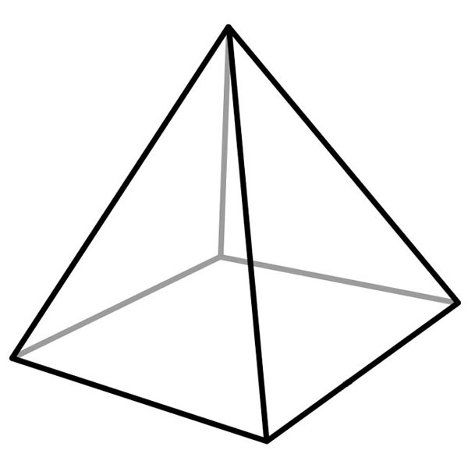
National 5 Applications of Maths
Perimeter, Area and Volume
Volume of a Cone
$$V=\frac{1}{3} ×B_{A} ×h$$
B_{A} stands for Area of the Base
Example 1: Find the volume of this Cone.
7cm
5cm
5cm

Slide 27
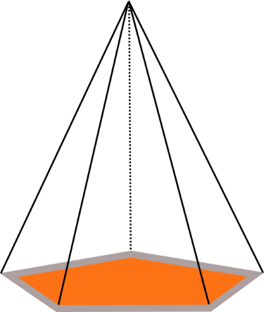
National 5 Applications of Maths
Perimeter, Area and Volume
Volume of a Cone
$$V=\frac{1}{3} ×B_{A} ×h$$
B_{A} stands for Area of the Base
Example 2: Find the volume of this Cone.
5cm
5cm
24cm²

Slide 28
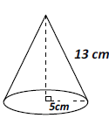
National 5 Applications of Maths
Perimeter, Area and Volume
Volume of a Cone
$$V=\frac{1}{3} ×B_{A} ×h$$
B_{A} stands for Area of the Base
Example 3: Find the volume of this Cone.

Slide 29
National 5 Applications of Maths
Perimeter, Area and Volume
Volume of a Sphere
$$V= \frac{4}{3} π × r^{3}$$
Example 1: Find the volume of this Sphere

Slide 30
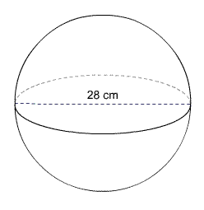
National 5 Applications of Maths
Perimeter, Area and Volume
Volume of a Sphere
$$V= \frac{4}{3} π × r^{3}$$
Example 2: Find the volume of this Sphere

Slide 31
National 5 Applications of Maths
Perimeter, Area and Volume
Volume of a Sphere
$$V= \frac{4}{3} π × r^{3}$$
Example 3: Find the volume of this Hemi-Sphere
4.5cm

Slide 32
National 5 Applications of Maths
Perimeter, Area and Volume
Exam Questions
Example 1: Find the volume of this shape.

Slide 33
National 5 Applications of Maths
Perimeter, Area and Volume
Exam Questions
Example 2: The following is a large cylinder with a smaller cylinder removed.
Find the volume of this shape.
8cm
15cm

Slide 34
National 5 Applications of Maths
Perimeter, Area and Volume
Exam Questions
Example 3: The following is a design for a swimming pool in a local community centre.
Calculate the volume of the pool in litres.
12m
0.4m
3m
1.8m

Slide 35
National 5 Applications of Maths
Perimeter, Area and Volume
Surface Area
Example 1: Calculate the surface area of this Cuboid.
6cm
5cm
8cm

Slide 36
National 5 Applications of Maths
Perimeter, Area and Volume
Surface Area
Example 2: Calculate the surface area of this Cuboid.
20cm
30cm
10cm

Slide 37
National 5 Applications of Maths
Perimeter, Area and Volume
Surface Area
Example 3: Calculate the surface area of this Prism.
5cm
4cm
12cm
6cm

